Slide 1
Public Accountability Meeting Out of Court Disposals
Chief Inspector Richard Ogden

Slide 2
Areas to cover
Provide an overview of adult and youth Out of Court Disposals (OOCD) and how they are applied in North Yorkshire
Oversight and scrutiny of OOCD
Diversion schemes operating within North Yorkshire, with a focus on ‘Crossroads’ adult OOCD pathway.
Youth Justice, with a focus on the Youth Outcome Panel
The future impact of the Police, Crime, Sentencing & Courts Act 2022 on the adult OOCD landscape
Plans moving forward

Slide 3
Out of court disposals
Not intended for serious, persistent or contested cases, where court will always be the right forum for deliberation and adjudication.
OOCDs allow the police to deal swiftly, proportionately and appropriately with low-level offending without recourse to the courts.
This may be achieved via reparative, rehabilitative or financial or conditions dependent on the disposal and circumstances
An opportunity to provide intervention and support to address offending behaviour and potentially identify the root causes of offending at the early stages in criminal behaviour
Vital that as either a victim or perpetrator we care about the people with whom we interact, whatever that reason for the interaction
Provide a joined-up Criminal Justice partnership approach to support the victim and offender
Notes:
Reduce demand on the courts for matters suitable to be retained by the police.

Slide 4
Evidence led policing
An evidence review commissioned by the NPCC in 2018 about the use of Out of Court Disposals by Cambridge University found that;
OOCD’s, whether with conditions or without, are effective, compared to court prosecution, at reducing harm and reoffending and sustaining victim confidence and satisfaction. This finding applies to young offenders, young adults and adults;
OOCD’s are effective with low harm, low risk offenders but they may also be effective with moderate risk offenders;
OOCD’s with conditions appear to be promising in reducing harm, including domestic violence;
In order to be effective, OOCD’s with conditions must be implemented well, and three areas require particular attention: the eligibility screening of offenders; the needs assessment to match conditions to the offender; the setting and tracking of conditions;

Slide 5
Diversion - Challenges
Wider research indicates that up-tariffing can increase re-offending: When interventions entail greater involvement in the justice system than would have otherwise been the case, such as disposals which require completion of conditions when there would have been no conditions beforehand, this evidence also suggests it can actually increase re-offending.
Achieving the right balance in terms of identifying whether prosecution or a formal or informal OOCD is suitable taking into consideration legal obligations, national and local guidance and the individual circumstances of the offence.
Cultural challenges to overcome. Getting the ‘buy in’ from the police and the public to alternative outcomes.
Ensuring the availability of suitable pathways and/or conditions
Notes:
Refer to Justice Innovation.Org – where early interventions de-escalate contact with the criminal justice system, there is strong evidence internationally, and moderate evidence from the UK that pre court dicersion reduces reoffending. Moreover we found that there is moderate evidence that pre court diversion reduces the costs to the criminal justice system and promising evidence on the impact of pre court diversion on victim satisfaction

Slide 6
OOCD options for Adults
Cannabis/Khat Warning
Community Resolution
Penalty Notice for Disorder (PND)
Simple Caution
Conditional Caution
Outcome 22 – Drug/Alcohol referral, ‘Crossroads’
Notes:
A brief explanation will be provided about each of the disposals

Slide 7
Cannabis/Khat Warning
Cannabis is a controlled drug under Class B of the Misuse of Drugs Act 1971. Cannabis warnings are a non-statutory disposal introduced in 2004 and are part of an escalation procedure for a first-time offence of simple possession of Cannabis. Providing there are no aggravating factors, an offender may receive a Cannabis Warning for a first possession offence
A Cannabis warning applies to adults over the age of 18 years possessing Cannabis for personal use only. It is an informal, verbal warning given by a police officer to an offender, either on the street or in a police station. No more than one Cannabis Warning can be administered.
Khat became a controlled drug under Class C in 2014. The process mirrors that of the Cannabis Warning.
Notes:
Refer to numbers issued

Slide 8
Community Resolution Disposal
Voluntary agreement generally between victim and offender which can include elements of restorative justice, and can be used for adults or youths. They are a method of dealing with an offender for a lower-level crime, in a way which is proportionate.
Resolutions can be offered when the offender accepts responsibility for offending behaviour and, in most cases, where the victim has agreed that they do not want more formal action taken.
By encouraging offenders to face up to the impact of their behaviour and to take responsibility for making good any harm caused, a community resolution can reduce the likelihood of their reoffending.
The most appropriate offences to warrant a community resolution are likely to be low-level criminal damage, low-value theft, minor assaults (without injury) and anti-social behaviour. There is an eligibility criteria and some circumstances require supervisor authority
Resolutions can include the offender being given advice about their behaviour, apologising or sending a letter of apology to the victim, or making some form of reparation such as repairing or paying for any damage done.
Hate Crime Awareness course delivered by Restorative Solutions
Challenges around repeat use and ineffective conditions
Notes:
Explain how the agreement works for victim
Refer to numbers issued, inc Hate crime
Refreshed national guidance to be published

Slide 9
Penalty Notice for Disorder (PND)
A PND is a statutory disposal established by the Criminal Justice and Police Act 2001. It is a financial punishment (fine) to manage low-level, anti-social and nuisance offending and can be administered on the spot or in a police station. It targets adult offenders aged 18 and over.
PNDs can be issued for 29 specified penalty offences, including:
being drunk and disorderly in a public place
retail theft under £100
behaviour likely to cause fear, alarm or distress
criminal damage (up to a value of £300) and cannabis possession
Two levels of PND fines can be administered (£90 or £60). A PND recipient has 21 days in which to either pay the penalty or request a court hearing.
Notes:
Refer to numbers issued and offence types
Not available from 1/4/23

Slide 10
Adult Simple Caution/Conditional Caution
Simple Caution - This is a formal warning given to an adult who has admitted an offence. It is used when it is not in the public interest to prosecute an offender. No conditions attached.
Conditional Caution - This is a caution, with one or more conditions attached,
Conditions - Rehabilitation Reparation, or Punishment (financial penalty)
Rehabilitative conditions can include attendance at a treatment course. Reparative conditions can include apologising to the victim, paying compensation and repairing any damage caused. The conditions must always be appropriate, proportionate and achievable.
If the offender does not comply with the conditions then the police can review the breach and may escalate the disposal to a charge to court.

Slide 11
Outcome 22
This a Home Office (HO) outcome code intended to reflect where a diversionary, educational or intervention activity has been used to result a case that does not meet the public interest test to take any further action.
It can be used where diversion is an alternative to prosecution (reduce first time entrants) such as via a deferred caution/charge pathway
Much good diversionary work is done by policing, often in partnership with other agencies, that does not fall within a recognised OOCD outcome within the current HO outcomes framework.
Great value in the use of informal disposal options as an early intervention and likely to have a greater impact on reducing reoffending. Opportunity to prevent criminalisation, address the offending behaviour and provide support.
Notes:
Refer to examples of Outcome 22 - Young people - Op Choice, Route 22 (Youth Outcome Panel), Alcohol referral
Adults – Drug/Alcohol referral, Crossroads Diversion

Slide 12
OOCD options for Young people (under 18)
Community Resolution Disposal
Youth Caution/ 2nd Youth Caution
Youth Conditional Caution
Outcome 22 – Op Choice, Alcohol referral, Route 22

Slide 13
Youth Caution (YC) and Youth Conditional Caution (YCC)
Youth cautions/Youth Conditional Caution are statutory out-of-court disposal, introduced in 2013 under the Legal, Aid, Sentencing and Prevention of Offences Act 2012 (LASPO).
The police can make the decision to offer a youth caution. The police must refer the young person to the youth offending team (YOT) for assessment and voluntary conditions if a second YC is being considered. However, in North Yorkshire all decisions for YC are made via the YOP
A YCC is a caution with mandatory conditions attached that are appropriate, proportionate and achievable.
The police consider whether an offender is suitable to be offered a conditional caution based on the national gravity matrix score and any previous interventions offered (if applicable). The young person must then be referred to the Youth Justice Service for mandatory assessment. Once the assessment is complete, the police and YJS together decide on the appropriate conditions to attach to the youth conditional caution. Compliance with the conditions is monitored by the YJS
Notes:
Relaced escalating steps of Reprimand, Final warning, Charge

Slide 14
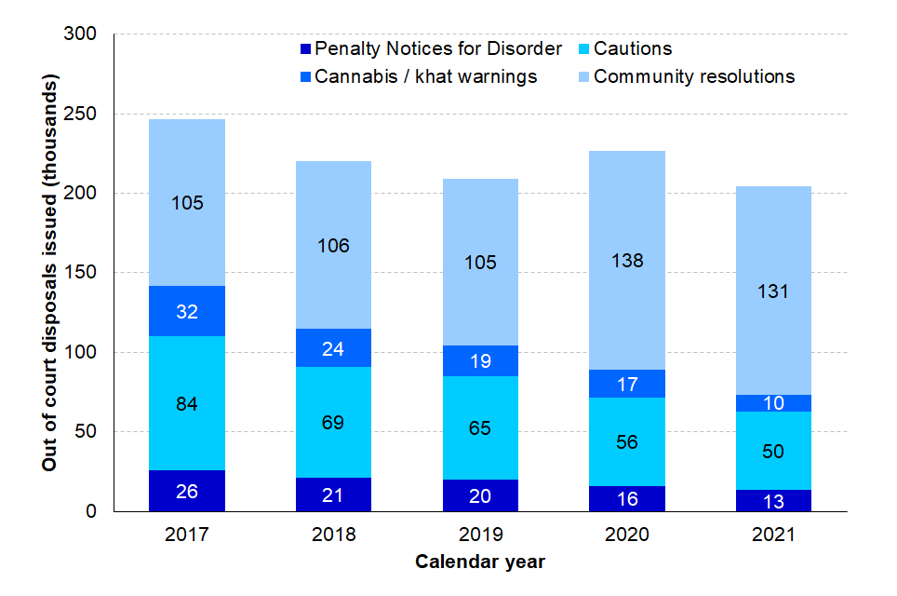
OOCDs issued, 2017 to 2021, England and Wales
(Source: Gov.uk Criminal Justice statistics December 2021
Notes:
Explanation of data to be provided during presentation - There were 204,000 OOCDs in the year ending December 2021, a 10% decrease compared to the previous year. This was driven by decreases across all types of OOCD. Community resolutions accounted for 64% of all OOCDs in 2021.
The use of Penalty Notices for Disorder (PNDs) continued to decline with 13,300 issued in 2021, falling 16% from the previous year. The most common offences that resulted in a PND were possession of cannabis, accounting for 37% of PNDs, and drunk and disorderly behaviour accounting for 38%.
There were 10,400 cannabis and khat warnings issued in 2021, a decrease of 40% since 2020. This is consistent with their ongoing decrease (down 68% since 2017). In 2021, 49,700 offenders were given a simple or conditional caution . Cautions issued continued to fall since 235,000 were issued in 2011(representing a 79% decline over the decade). Just over half (56%) of cautions issued in 2021 were for indictable offences. Most offence types were consistent with this decline, except for violence against the person. This has seen a 35% increase since 2018, primarily due to the introduction of the Assault of an Emergency Worker offence, for which cautions issued increased 14% in the most recent year. OOCD for AEW offences – considerations.

Slide 15
Use of Cautions in North Yorkshire
Notes:
Decrease in Adult Cautions due to introduction of Crossroads in May 2021 as an alternative to caution
Average of 46 Adult Cautions per month in 2021/22. Discuss crime types for both Caution and Conditional Caution

Slide 16
Oversight and scrutiny
Authorisation and administration of all OOCD's must be completed lawfully, legitimately, ethically and in accordance with local and national policy and guidance.
Supervisors are responsible for ensuring that officers use OOCD’s appropriately and proportionately.
Gatekeeping functions and internal dip sampling
We promote the appropriate use of OOCDs through guidance, training and monitoring as well as feedback to individual officers and their supervisors.
Internal oversight/governance– OOCD & Diversion Board, Business Development & Innovation Board (under the Local Criminal Justice Partnership
External oversight – Independent Scrutiny Panel, Youth Justice Service Management Board, Her Majesty’s Inspectorate of Constabulary and Fire Rescue Service (HMICFRS)
Notes:
This is key to ensuring crime data accuracy, improving victim satisfaction, maintaining confidence and appropriately addressing offending behaviour.
Formal OOCD’s also require authorisation from a supervisor of Sergeant or Inspector rank before they can be used.
. Support is also now provided via a dedicated OOCD Lead and a Police Sergeant

Slide 17
Crossroads Pre-Court Diversion Scheme
This route is for those aged 18+ who have committed a criminal offence and have been arrested or agreed to voluntary attendance at a police station, where the outcome would normally be a caution or a charge.
Launched in May 2021. Commissioned service from the OPFCC.
There is an agreed eligibility criteria and if met then the offender may be deemed suitable for consideration of diversion
The pre-court diversion route is an alternative to prosecution, if the individual agrees to a referral to the Crossroads diversion scheme then engagement involves agreeing to certain conditions which then become mandatory.
There is a keyworker assigned to each case/client
Lack of engagement may result in the traditional criminal justice process (caution or charge to court)
Notes:
Commissioned service delivered by Humankind – aims
Community/voluntary route as well that can be accessed outside of NYP

Slide 18
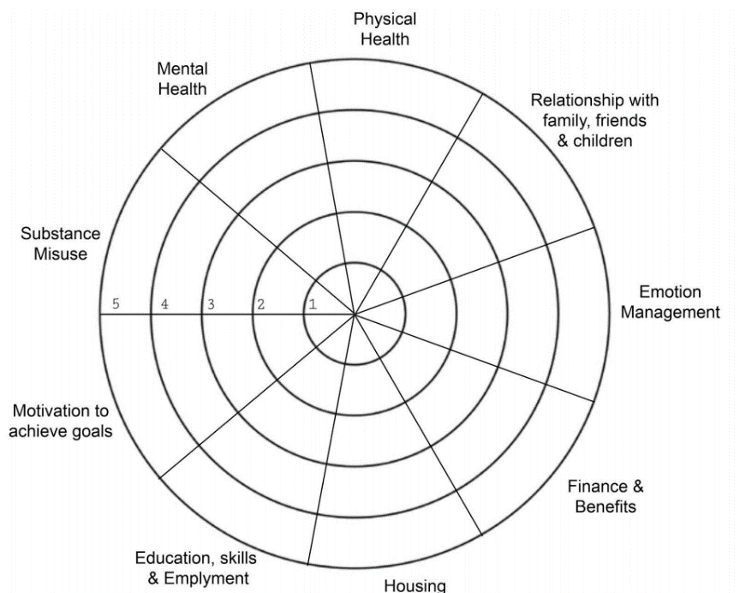
Crossroads Diversionary Scheme - Process
Initial Assessment
Identified Needs – Interventions agreed
Support Plan conducted with keyworker
Referral to Restorative Solutions
Signposting/Referrals to Partner Agencies
Continued Support
Notes:
Trauma informed approach – holistic approach. Wellness Wheel.

Slide 19
Crossroads Referrals by Age Group April 2022
Women | April-22 | May-21 to Apr-22
18-25 | 6 | 44
26-39 | 7 | 63
40-59 | 3 | 50
60+ |  | 7
Men | April-22 | May-21 to Apr-22
18-25 | 9 | 80
26-39 | 11 | 71
40-59 | 5 | 47
60+ | 1 | 8
18-25
26-39
40-59
60+

Slide 20
Crossroads Offence Profile (Out of Court Disposals) May 2021 to April 2022
Offence | Women | Men | Total
Assault | 62 | 66 | 128
Theft | 23 | 14 | 37
Public Order | 13 | 14 | 27
Criminal Damage | 8 | 15 | 23
Harassment | 10 | 12 | 22
Drug Possession | 4 | 12 | 16
Obstruction | 2 | 7 | 9
Possess Offensive Weapon | 1 | 7 | 8
Hate Crime | 1 | 4 | 5
Child Neglect | 3 | 1 | 4
Cyber Crime | 1 | 3 | 4
Arson | 1 | 3 | 4
Drug Cultivation | 2 | 2 | 4
Wasting E/S Time | 1 |  | 1
Offence Profile by Gender

Slide 21
Crossroads Data
From May 21 to March 22 - 330 referrals made to Crossroads, of which 257 were via the OOCD route
Of those referred to the OOCD element of the scheme, 119 were women and 138 men. 77% successfully completed and exited the scheme and were diverted away from the Criminal Justice System.
80% of those who successfully exited the scheme had improved outcomes and of those who completed service-user feedback, 100% would recommend the service.
A review is underway by the OPFCC to look at reoffending rates of those that have successfully completed the scheme

Slide 22
Crossroads Case Study
Case Study – Case C
C was referred via the OOCD Diversion route by NYP following an incident of burglary and criminal damage. C stole his siblings Nintendo Switch and the family laptop, selling them to fund Cannabis use and drug debts. This was his first offence and he admitted to it fully in interview. C had been sleeping in a shed in the family garden. C’s goals (whilst engaging with Crossroads) were;
to abstain from cannabis,
to be in his own accommodation and;
to be on better terms with family and to gain employment.
Whilst on the programme, C completed sessions on cannabis use, managing emotions, finance and budgeting, conflict resolution, housing support and employment support. C is now in temporary accommodation, abstinent from cannabis, engaging with services, debt free, and his relationship with his family is much improved. After finishing all his requirements for his OOCD option, C is now engaging with us voluntarily for additional support until he moves into permanent accommodation.

Slide 23
Youth Justice
Work collaboratively with Criminal Justice partners
Seconded police officers working within the Youth Justice Service in North Yorkshire and City of York
Partnership Hub – Schools Liaison officers
Voluntary referrals – Change Direction , Triage & Diversion, Other OPFCC supported voluntary diversionary services
Youth Outcome Panel

Slide 24
Youth Outcome Panel
Established in 2017
Child and victim centred focus
Meets fortnightly – virtually or face to face
Police and YJS from NY and City of York – practice managers and victim liaison officers
In 2021 the Panel sat on 27 occasions, making decisions regarding 195 referrals.
Panel aims/responsibilities
To encourage joint decision making between the police and YJS to promote positive outcomes for children, young people and victims
To enable restorative approaches with victims
To divert young people into services that seek to address the causes of their offending behaviour
To provide safeguards against inappropriate disposals, including inappropriate repeat cautioning and unnecessary entry into the criminal justice system
To reduce First Time Entrants to the Criminal Justice System
To ensure appropriate outcomes for disadvantaged young people e.g. Children in Care
Notes:
Strength / success

Slide 25
Assessment and Decision Making
All appropriate young people are referred by the police to the relevant YJS for an assessment to be prepared, covering their strengths, needs, circumstances and risks.
Victims are contacted to ensure that the panel considers the impact of the offence, and to maximise restorative outcomes.
In coming to a decision about an appropriate outcome, the Panel takes into account the following factors:
The young person’s offending history, willingness to comply with possible interventions, the likely outcome if they were to be prosecuted, their engagement history and their personal circumstances, which will include their strengths and their family support networks
The seriousness and circumstances of the offence,
The views of the victim
Notes:
VLOs are part of the panel

Slide 26
HMI Probation review of Youth offending in North Yorkshire – September 2020
In relation specifically to the Youth outcome panel it was mentioned in the final report that;
There are clear lines of accountability
A wide variety of information is gathered to assist decision-making
A good professional relationships between the YJS and the police enable the YJS to contribute effectively to decision-making for out-of-court disposals and, when needed, provide effective challenge.
There is a shared culture of making decisions in the best interests of the child, while considering the wishes of victims.
In every case, the rationale for joint disposal decisions was clearly recorded, and inspectors agreed with the decisions made in most cases.
Recommendations made by the YJS considered the extent of the child’s understanding of the offence and their acknowledgement of responsibility.
Notes:
ROUTE 22 perfect for those on the cusp of a YC/YCC to offer an alternative to becoming a first-time entrant. Results in No further/formal action on the crime and closed as Outcome 22
Conditions agreed at YOP and process managed by YJS worker.
Action Plan agreed with bespoke conditions lasting up to 16 weeks
Breach of the plan may result in an escalation to another outcome
Provides an opportunity for YJS to work closely with that young person over a longer period than a Community Resolution

Slide 27
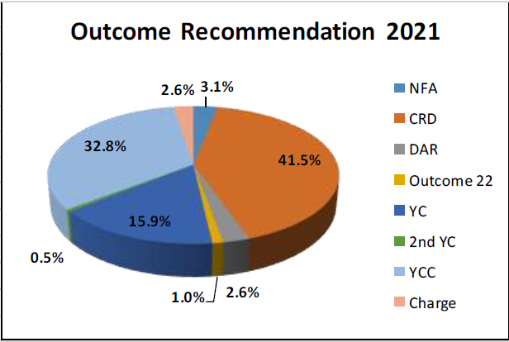
Youth Outcomes
85% reduction in First Time Entrants into the Criminal Justice system since 2017
Reoffending rates after YOP are approximately 7.9% within 3 months and 26% within 12 months.
2020/21 - A welcome reduction was seen in the proportion of referrals from Scarborough District; however, it remains disproportionately represented in the number of First Time Entrants.
2020/21 - The percentage of children and young people who were re-referred to the Panel decreased, with those re-referred within 12 months down from 21.8%to 18.0%.
102 of 133 North Yorkshire Children at YOP in 2020/21 had no previous referral
Notes:
Primary offence – Assault. Watch videos/BWV
Refer to reoffending rates being significantly better than the wider cjs cohort
Since introduction – YOP outcomes approx. half

Slide 28
New YOP outcome – introduced May 2022 ROUTE 22
No requirement for 28-day compliance i.e., CRD. Allows key worker at YJS to engage with child for longer
Similar to what is currently available for adult offenders via Crossroads.
Expectation that conditions will last no longer than 3-4 months
Non-compliance may be returned to panel for consideration of escalation to formal outcome. Something not normally available via CRD process
Great example of partnership working
Perfect for those on the cusp of a YC/YCC to offer an alternative to becoming a first-time entrant. Results in No further/formal action. Crime closed as Outcome 22
Notes:
Try to bring an example - too early for a success story

Slide 29
Police, Crime, Sentencing & Courts Act 2022 Changes to Adult OOCD Framework 1/4/23
Move to 2 Tier + framework. Statutory - Diversionary Cautions & Community Caution)
Focus on restorative conditions
No more Simple cautions, Cannabis Warnings or Penalty Notices for Disorder
Making the criminal justice system work better by improving OOCD and diversion schemes.
Notes:
Challenge by removing SC, CW and PND despite best intentions

Slide 30
What are our challenges
The impact of the changes and how we implement them effectively and with confidence in North Yorkshire.
How to provide consistent and fair decision making to offenders based in North Yorkshire and beyond
Ensuring we have an effective and available suite of conditions to attach to disposals.
Informing the front line and ensuring appropriate ongoing support is in place to manage the changes
Promote the changes simply and effectively
Notes:
Consistency in outcome decisions
Proportionate decision making. Consideration of out of area offenders
How will compliance be monitored and recorded?
How/where our current deferred caution/charge schemes fit in – desire to retain a deferred caution but expand Crossroads to deliver under the new Diversionary and Community Cautions

Slide 31
What are we doing to prepare?
Dedicated OOCD police lead and project manager
Establishment of an OOCD and Diversion Board in 2021
Represented at NPCC and MOJ meetings and various working groups/forums
Networking and scoping
Engagement with internal and external key stakeholders
Identifying how we can make this work practically and to get the ‘buy in’ and understanding from officers
Business case prepared recommending introduction of an OOCD team to provide consistent decision making and support the front line.

Slide 32
Aims and Results over the next 12 months
Ensure a state of readiness for the new Adult OOCD framework in terms of decision-making, pathway expansion e.g. Crossroads and introduction of operational delivery model
Seek to understand more about reoffending rates
Create a mechanism for recording OOCD disposals and associated conditions to enable data extraction as part of internal and external scrutiny
Promote greater understanding and acceptance of Restorative Justice across all Criminal Justice outcomes
Monitor and review the Youth Outcome Panel Route 22 initiative. Retain gatekeeper role at point of initial referral
Supporting the drive for Prevention & Early Intervention and encouraging officers to ‘Think Diversion’ where appropriate via OOCD and in the wider context via the ‘Pathways’ directory
Supporting ongoing delivery of the OOCD Independent Scrutiny Panel

