Slide 1
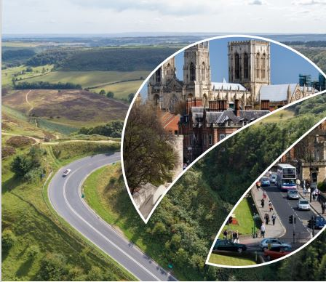




Slide 2
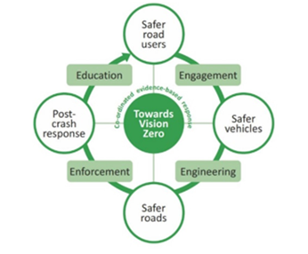
Overview
The partnership includes North Yorkshire Police, North Yorkshire Fire & Rescue, City of York Council, North Yorkshire Council, York & North Yorkshire Combined Authority , National Highways and the Yorkshire Ambulance Service.
Collectively we work to reduce the number of people killed and seriously injured on our roads. Working towards Vision Zero.
The partnership incorporates the Safe System of road safety and focuses on Education, Engagement, Engineering and Enforcement.

Slide 3
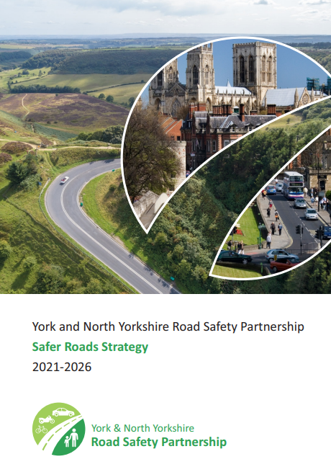
Background
The partnership was re-invigorated in 2021, and a 5-year strategy was produced.
Funding of £300,000 was allocated by the OPFCC utilising budget from North Yorkshire Police and North Yorkshire Fire & Rescue. This funding comes to an end in March 2026.
2021 - 2023
  Partnership Participation was limited
  Workstreams and initiatives proposed and costed but not implemented
  Approval for Road Safety Partnership Coordinator in principle
  Meetings held online as we were coming out of Covid
  Three Chairs in less than three years
  Lack of clear Governance/Infrastructure/Ownership
  Was it a partnership? Or somewhere to report your Road Safety Work.
  Strategy had 46 Objectives over the 4E’s
  Lots of legacy communication literature, information and social media campaigns .

Slide 4

2023 – present
We have an updated, simplified strategy with 17 manageable objectives and Our first annual report on our work as a partnership will be available in September 2025
We have well attended, in person meetings at both Strategic and Tactical level with a new Terms of Reference in place for the Strategic meeting and one currently being drafted for the Tactical group.
We have a multi-agency approach using the basis of NYP’s Summer and Winter roads policing plans with an annual strategic planning cycle embedded in the partnership.
Partnership Co-Ordinator is in place ensuring we deliver targeted and focused work this has included;
  Tactical Delivery plan aligned with National Operations and flexibility to adapt to regional needs
  Education packages written to ensure consistent messaging. These have also been adopted by Staywise, the NFCC national platform for blue light education
  Access to funding with a clear spending plan and transparent internal application and governance processes
  Invested in branded assets, materials and produced campaign literature to assist with engagement
  Forming relationships with other road safety partnerships and organisations and providing representation at national conferences and networking events
  Launched new social media channels and website
Purchased the speed management tool by Agilisys to support our Speed Management Protocol and focus activity
Undertaken academic research to ratify our current and future work

Slide 5

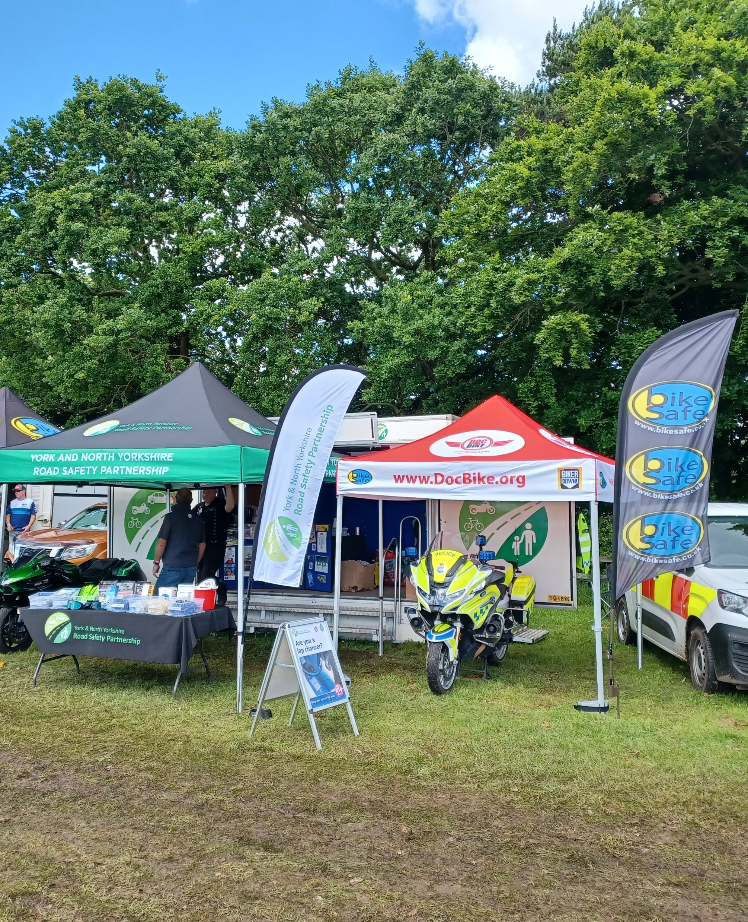

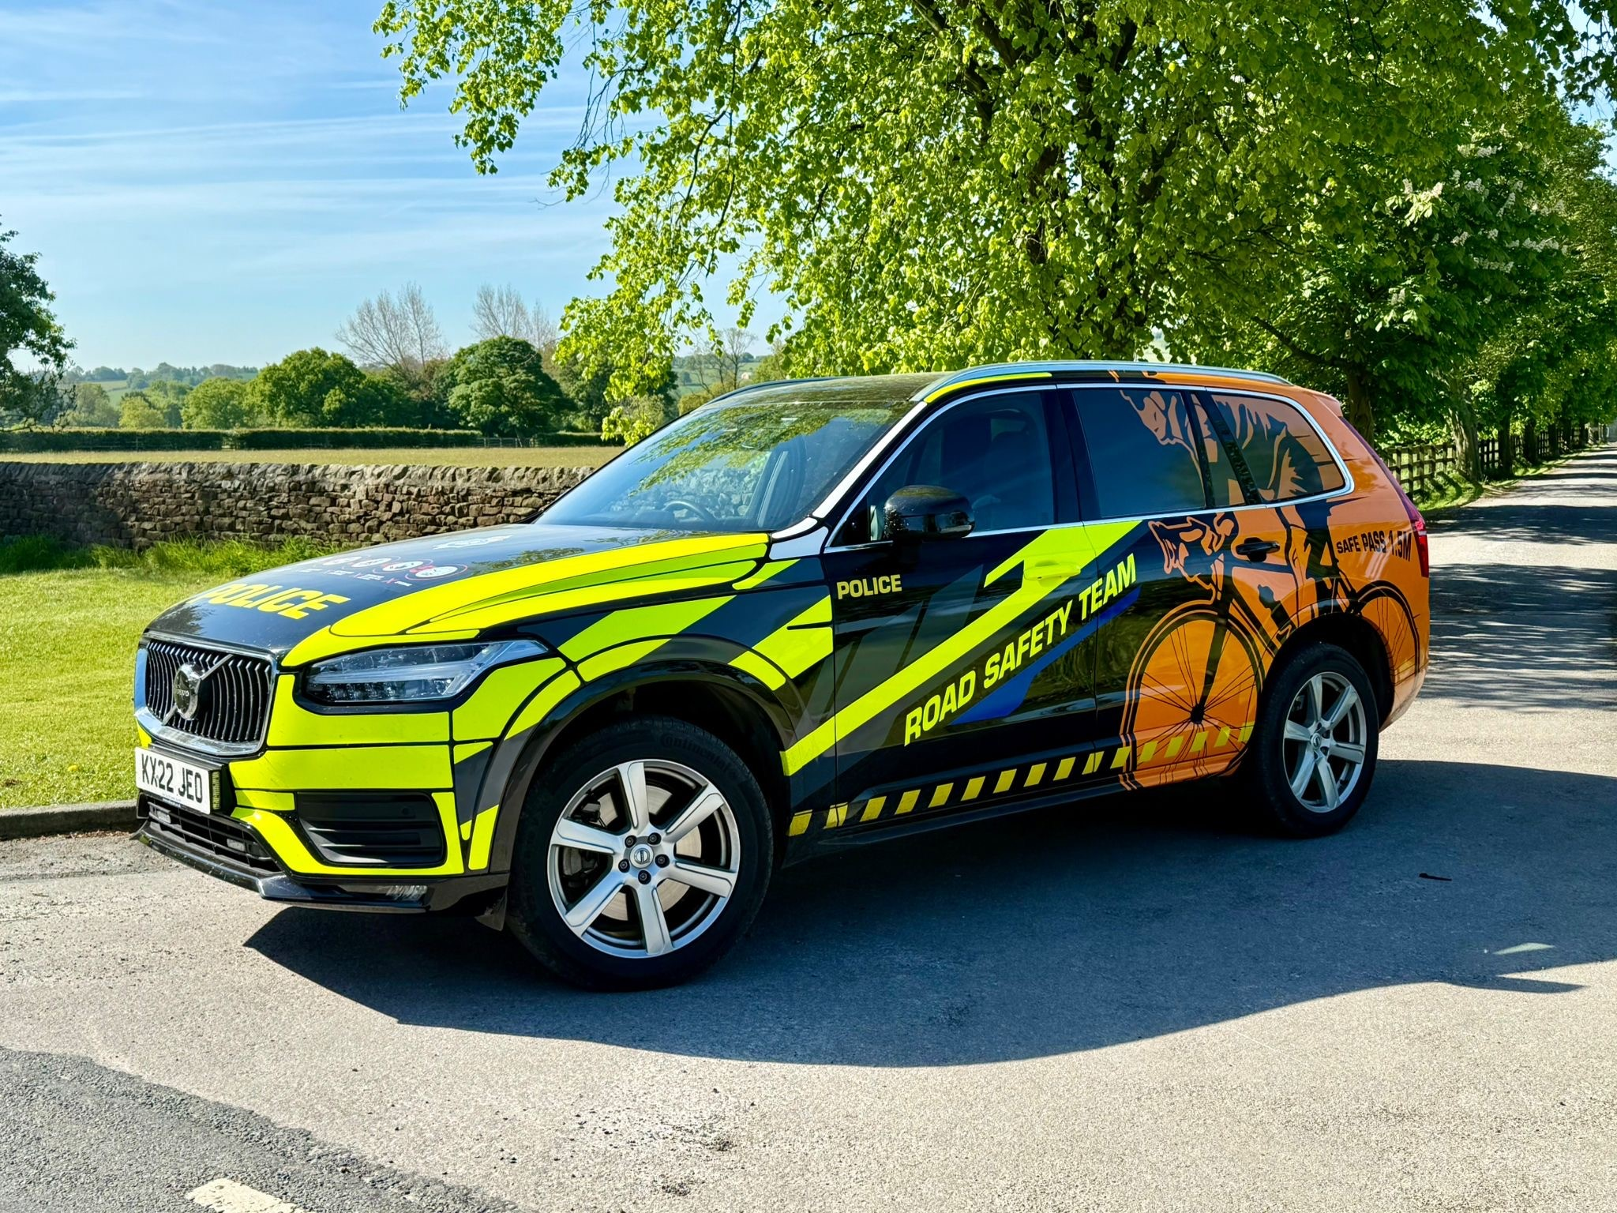
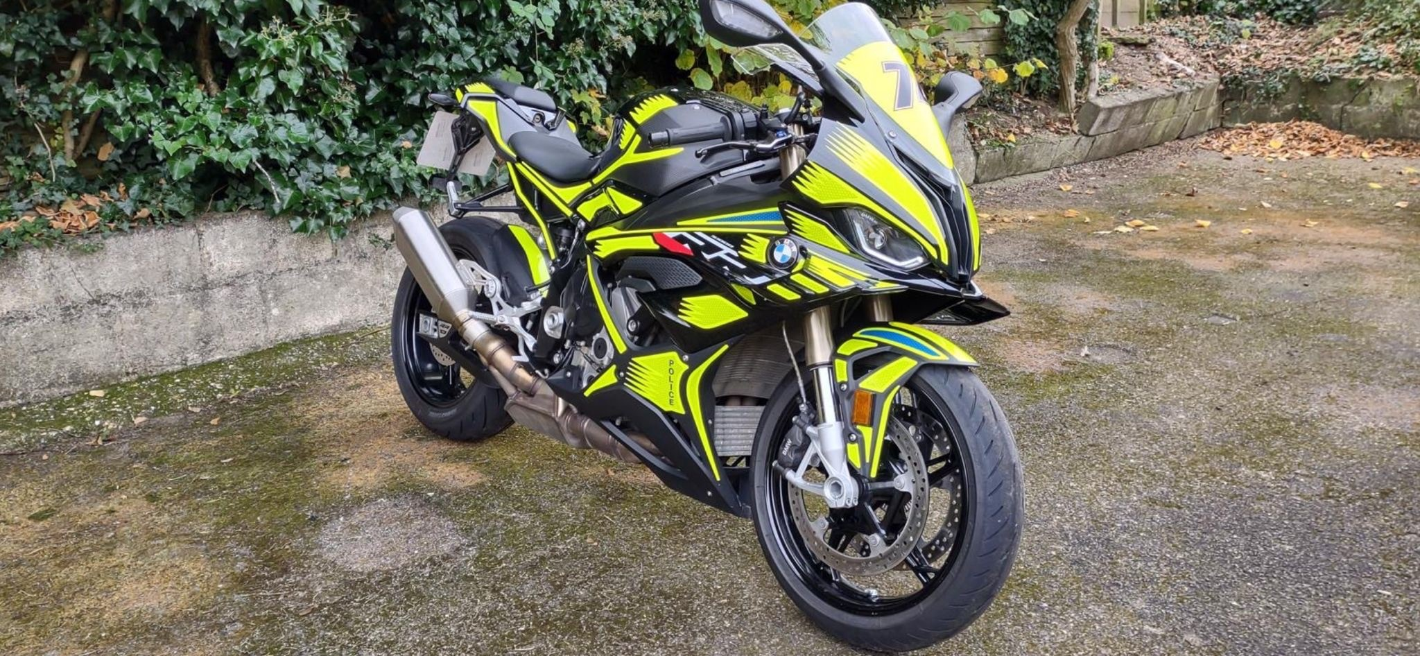
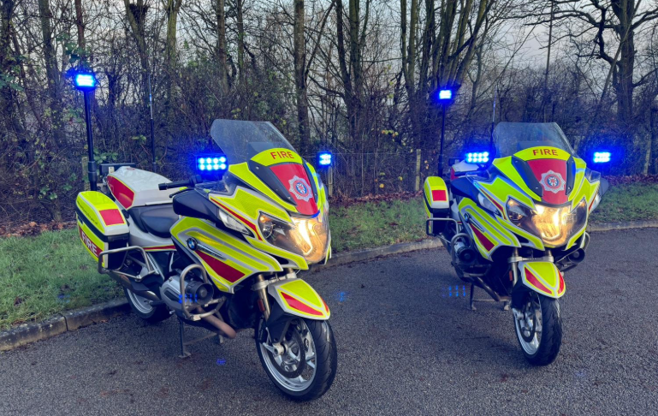
Tactical Delivery
2024 was the first full year of co-ordinated
delivery and we achieved the following:
  13 Biker Down courses
  21 BikeSafe workshops
  21 primary school assemblies
  29 secondary school, college, young driver talks
  13 talks to military personnel
  29 engagement events (e.g. Yorkshire Show, Olivers Mount, Dark nights campaign)

Slide 6
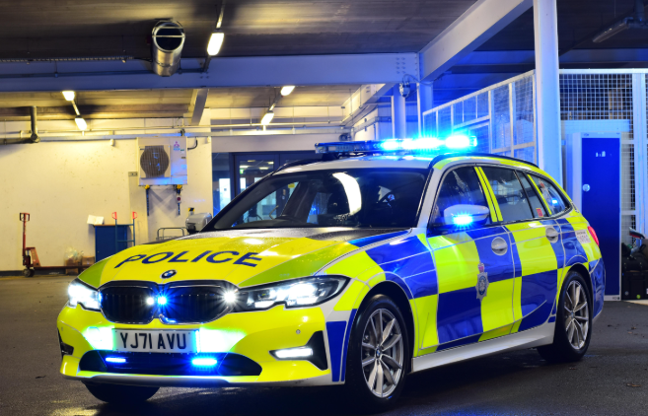
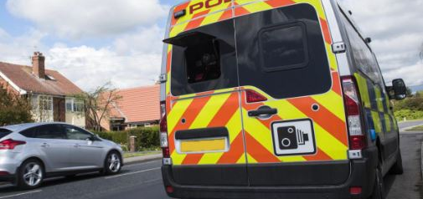
Targeted operations carried out by NYP Road Safety Team and Roads Policing Group in 2024.
This included commercial vehicle checks with DVSA and other agencies as well as drink/drug drive and no insurance campaigns aligned to the NPCC calendar.
During the summer deployment plan 2024 the Safety Camera Vans recorded
  12,154 offences
  10,277 drivers were offered courses through NDORS
  3,231 hours of enforcement
Safety Camera Deployments are planned twice a week and, in each case, consider the staffing and vehicles which are available.
Safety Camera locations are highlighted through collision statistics collection (KSI Routes) and Community Concerns (via Speed Management Protocol). Alongside this, Traffic Bureau will also take into consideration any joint Operations with RPG, Road Safety Team, NPT, Other Forces as well as Summer & Winter Deployment plans.
Each time the Safety Camera Deployments are prepared, local events and expected weather conditions also form part of the planning.
With the versatility of the Safety Camera Vehicles being able to capture numerous offences (mobile phone, seatbelt, due care, etc.) and ANPR capabilities, they can also be used for monitoring in heavier traffic conditions such as on the approach to large scale events.
All sites used are fully risk assessed and are reviewed at least annually.
Safety Camera & Enforcement Activity
Notes:
NDORS = National Driver Offender Retraining Scheme

Slide 7
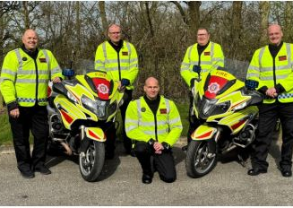
FireBike
FireBike is an initiative from North Yorkshire Fire and Rescue Service which is fully supported by the partnership.
Team of 6 comprising of 3 firefighters and 3 others who all volunteer their time.
Regular engagement at motorcycle venues across the county promoting advanced rider training.
Work closely with police motorcyclists and DocBike Yorkshire.
58 Deployments in 2024 / 378 hours
Educated 123 people via Biker Down in 2024

Slide 8
Data: 2023 Overview (Fatalities and Serious Injuries)
Source: Department for Transport
Data tells us where and when collisions are most likely to happen—and who is most at risk of serious injury.
We are data led to ensure that our Engagement, Education, Engineering and Enforcement resources are used in the most effective way.
Fatalities and serious injuries in 2023:
Around 7 in 10 were the driver.
Around 25% were Motorcyclists-despite making up less than 10% of road traffic.
Around 23% involved a younger driver (aged under 25) and 15% involved an older driver (aged over 70)
Around 7 in 10 were on our rural roads, most likely in a 60mph zone.
Notes:
By exploring road safety data, we can determine where and when collisions are most likely to occur and who is most at risk.
By understanding this information, we can target our Engagement, Education and Engineering and Enforcement activities.
The serious injury and fatality information from 2023 reflects historic trends in that:
Around 7 in 10 were the driver.
Around 25% were Motorcyclists-despite making up less than 10% of road traffic.
Around 1 in 4 involved a younger driver (aged under 25).
Around 7 in 10 were on our rural roads, most likely in 60mph zones.

Slide 9
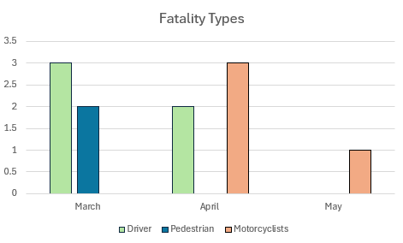
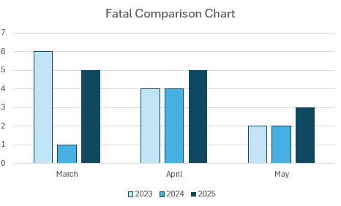
Data
The seasonal deployment plans for roads policing provide the central ‘spine’ to our work and partners look to align their work with this. The charts below show a snapshot of information from 2025 that was provided in the last meeting of the Strategic partnership board in June.

Slide 10
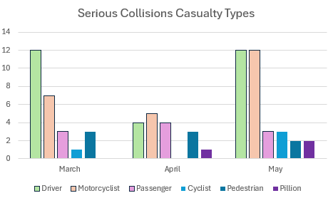
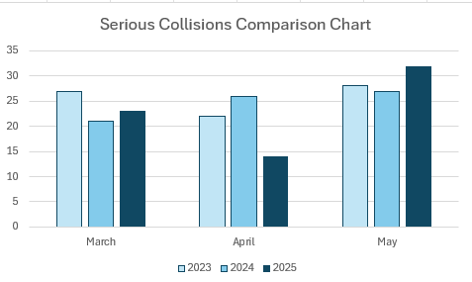
The data highlights areas of the county that are a cause for concern and the demographics involved.
Motorcycle casualties have been highlighted due to the good weather we have experienced so far in 2025 but we are sadly seeing an increase in collisions overall from last year.
The average cost of dealing with a fatal collision is £2,718,861 (data year 2023)
In 2023 44 people lost their lives on North Yorkshire roads
NYP data shows that this number reduced to 29 in 2024
Provisional data shows that there has been an increase nationally in road death.
Notes:
Average cost explanation : This figure comes from DFT data and covers the estimated real costs for lost output, medical and ambulance, police, insurance, admin and damage to property.
29 fatalities broken down as follows:
9 Drivers and 9 motorcyclists
4 passengers
4 pedestrians
2 cyclists and 1 tractor driver
(1 passed away more than 30 days after collision so won’t be in DFT figures)

Slide 11
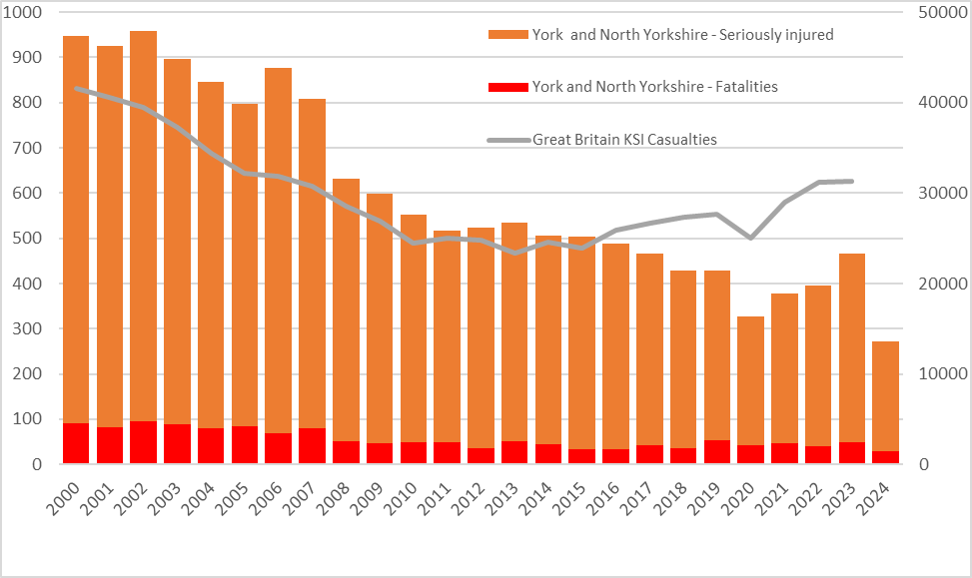
National trends
Notes:
2024 is not complete 12 month picture just to autumn. Formal DFT figures will be released in September

Slide 12

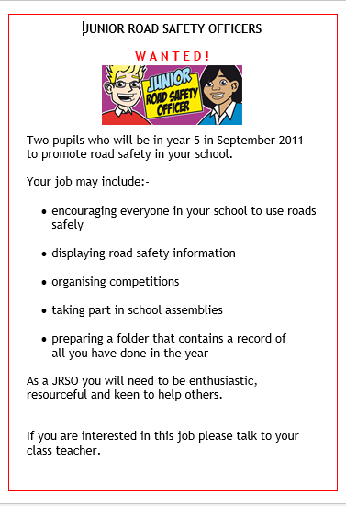
Future plans
Education and engagement are key to achieving behavioural change on our roads.
To further progress our work in these areas:
We are developing a programme for mature drivers to educate them and their families
on how natural changes that occur as we age can affect our driving and considerations around how we can address these.
Young driver education is an evolving project, staff have undertaken behavioural change training, and we are designing a package to be introduced to all secondary schools and colleges in the next academic year.
Re-introduction of the Junior Road Safety Officer scheme across all primary schools.
Enhanced seasonal engagement activity especially around the festive season and special events.
Continued development of the NYP Road Safety Team.

Slide 13
Future plans
The partnership has developed significantly over the last 2 years, and we would like to see this continue beyond March 2026, from a Strategic perspective we are:
Awaiting the release of a national strategy for Road Safety.
Holding discussions with the Combined Authority around aligning the strategic oversight of the partnership within the Transport Hub.
Looking at funding provision from March 2026 with ongoing discussions taking place.
Looking at the feasibility of a fixed camera network across the county and undertaking trials for this using new technology that has become available.
Considering adopting a Vision Zero Strategy.
Considering support of the Brake Road Victims Charter.
Working with Vision Zero West Yorkshire to undertake a peer review.
Notes:
Government have said this is being developed but there is no time given for this as yet
Discussions continue around funding and what this might look like across the partnership going forward
Incorporating Vision Zero – this has created lots of conversations within the partnership. Most partners have embraced the nature of Vision Zero and included it within their own plans. It needs to be understood that it is a shared responsibility between authorities and the public. We have not set any clear targets to aim for. If we formally adopt the Vision Zero ‘brand’ it needs to be communicated correctly.

