Slide 1

North Yorkshire Police Cybercrime, Digital Investigations & Fraud
August 2023

Slide 2
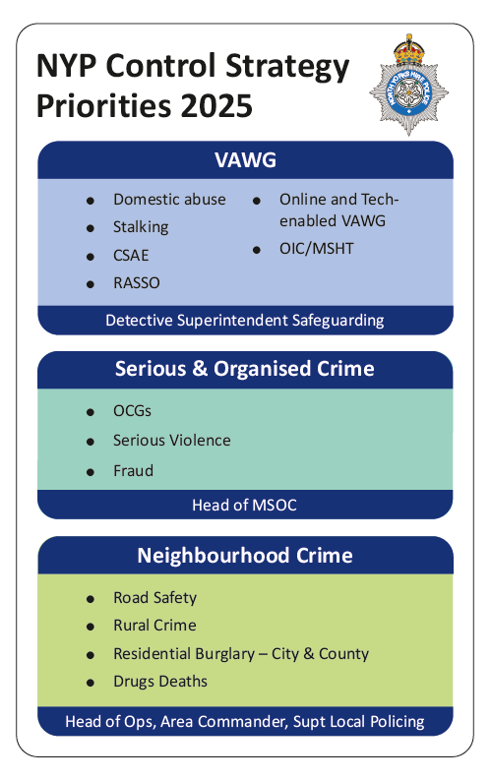
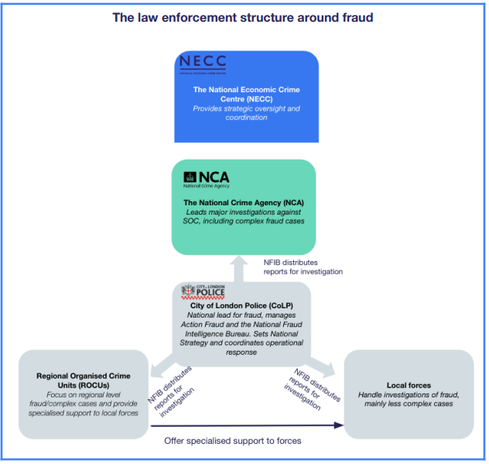
Strategy & Structure
Notes:
DI Janie Mitchell

Slide 3
Cybercrime Unit – The 4 ‘Ps’
PURSUE
Deter and disrupt state, criminal and other malicious cyber actors and activities against the UK, its interests, and its citizens.
PROTECT / PREVENT
Protect through building cyber security and resilience of UK and its economy, including safeguarding its citizens. Prevent people from cyber offending, remove enablers and reduce incentives of cyber crime
PREPARE
Strengthen capability to prepare for, respond to and recover from cyber-attacks to minimise harm caused and support victims.
Notes:
Insp Gavin Mayes

Slide 4
Economic Crime– The 4 ‘Ps’
PURSUE
Ensure there are the capabilities in place to investigate and action all NFIB packages.
PROTECT / PREVENT
Dedicated Financial Crime PROTECT officer
PREPARE
Ensure officers/staff have the right training & CPD to tackle the threat
Notes:
DI Janie Mitchell

Slide 5
Cybercrime Unit - Responsibilities
Primary Focus - Computer Misuse Act (CMA) Investigations: Hacking, Ransomware, Distributed Denial of Service (DDOS), Malware, Website Defacement
Investigative support to other departments “CMA-Linked Crimes”
Investigation opportunities
Support evidential captures
Communication data application support
Online Fraud/Scams, Harassment, Webcam Extortion/Blackmail, Phishing, Fake Websites
Technology facilitated abuse – Controlling/coercive behaviour, stalking/harassment
24/7 on-call – urgent serious/major crimes (e.g. murder, rape, organised crime, high-risk missing persons)
Notes:
Insp Gavin Mayes

Slide 6
ECU – Pursue Responsibilities
Partnership working – June 2025
Money mules recruited by fraudster to open bank accounts
Binance facial recognition systems identified fraudster
City of London Police investigation commenced, with several identified money launderers in our area
Combination of PACE & POCA powers used
Cryptocurrency capabilities – July 2025
Mobile phone seized and examined which showed evidence of cryptocurrency being used.
Sufficient information enabled cryptocurrency wallet to be rebuilt, and balance seized
S47M POCA -Realisable Property Detention Order secured
Notes:
DI Janie Mitchell

Slide 7
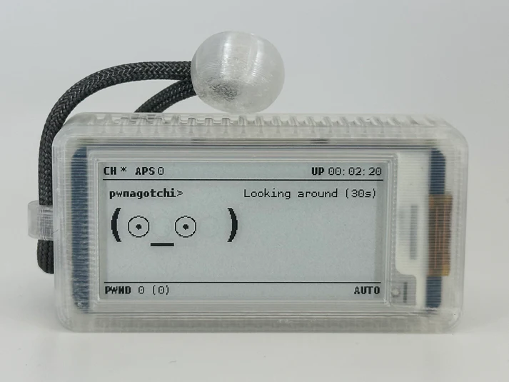
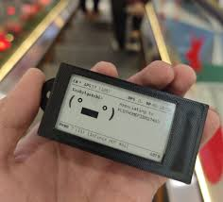
First in the UK – Cyber Pursue
2024 - intelligence regarding firearms printing lead to the arrest of an offender. NYP CCU were called in to assist in digital evidence identification and strategy.
The attending officer identified a Pwnagotchi – a mobile phone sized device that indiscriminatingly attacks home Wi-Fi routers and steals data allowing for the password to be cracked. Bad actors can then use the Wi-Fi connection to commit crime anonymously.
Notes:
Insp Gavin Mayes

Slide 8
First in the UK - Outcomes
Believed to be the only investigation into this device in the UK to date. In the UK alone there are over 3000 registered devices.
At the conclusion of the Digital Forensic Investigation into the Pwnagotchi device, the offender was offered and accepted a conditional caution with requirements to address offending through rehabilitation services partners.
Proactive safeguarding took place after digital forensic analysis of the device revealed data that allowed NYP CCU to locate and inform victims of the attacks that had taken place.
Examples of Safeguarded Victims:
Care Home
Local Government infrastructure
Multimillion pound private industry
Public Homes
Published in the Team Cyber UK law enforcement network briefing.
Contact made by other UK law enforcement officers regarding the investigation & sharing of best practice.
Notes:
Insp Gavin Mayes

Slide 9
Cybercrime Reports – 2025 (Q1, Q2)
Reports year to date:
193 reports to NYP CCU for breaches of the Computer Misuse Act 1990
176 Protect reports
18 Pursue investigations
140 Victims
ALL Victims contacted with Cyber Protect advice in line with 100% contact policy.
Outcomes year to date:
3 Arrests & Interview
5 Voluntary Attendee Interviews
2 Conditional Cautions (CMA & Fraud)
4 Charges (CMA | Make IIOC| Possessing Extreme Pornographic Material)
Notes:
Insp Gavin Mayes

Slide 10
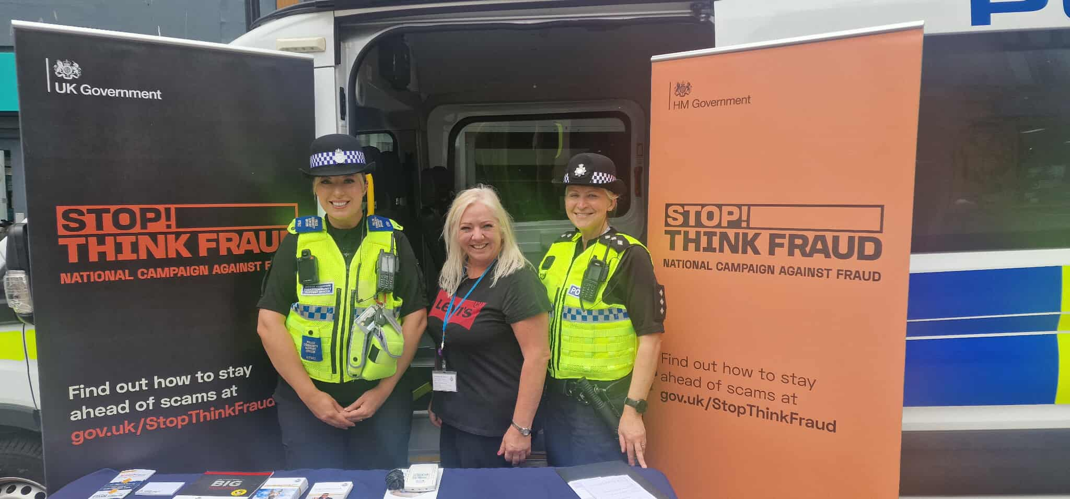
ECU - Protect / Prevent Responsibilities
FASO & Fraud Ambassadors
Virtual Kidnapping - Presentations to York University including to overseas students (Chinese / Mandarin translation)
Romance fraud awareness week
Notes:
DI Janie Mitchell

Slide 11

Operation Webhook – Protect / Prepare
Proactively identifying and notifying potential victims of cybercrime before they become a victim.
Cyber target hardening by reducing vulnerable systems
Very high success rate and very positive feedback
Educational Institutions
Local Government & Public Sector Infrastructure
Web Hosting Company
Several Small and medium-sized enterprises (SMEs)
Private individuals in residential settings
Notes:
Insp Gavin Mayes

Slide 12
Operation Webhook – Feedback
“I run MoD computers from here and my wife runs her NHS computer, thank you!”
“May I take this opportunity to thank you and North Yorkshire police for bringing this to our attention – this is a great service that we had no idea you provided.”
“Thank you for your e-mail. We are impressed by the police's proactive approach and would commend this kind of activity given the security threat landscape in the UK at present.”
“Good to hear from you again, and thanks for letting us know about this asset. I’ll speak to our Infrastructure team, and let you know their plans and any outcomes you need.”
“This information is definitely helpful and we really appreciate the heads up.”
“It's also good to find that at least North Yorkshire police are being pro-active in looking for vulnerable sites and alerting the owners, thank you.”
Notes:
Insp Gavin Mayes

Slide 13
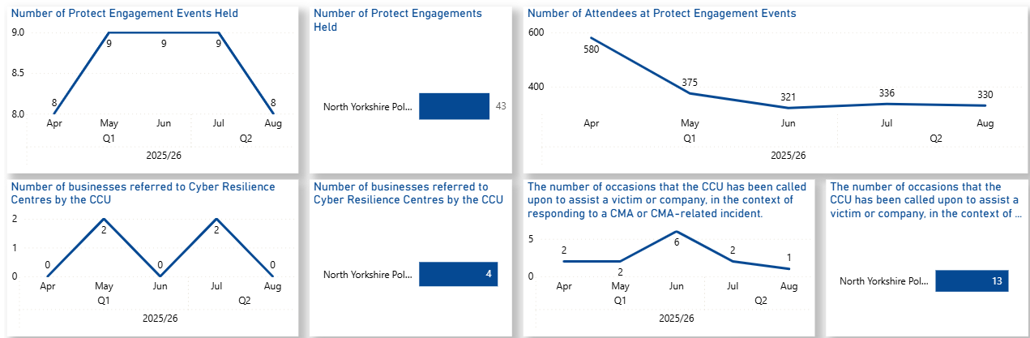
Performance Data
Notes:
Insp Gavin Mayes

Slide 14
Protect & Prevent – Public/Partner Education
Delivery of over 50 presentations to over 2000 individuals in the financial year to date. Including:
16 educational facilities
6 Youth Groups
5 Women specific groups including a joint dedicated day event Dalby Forrest Girls Wellbeing Festival
Multiple Carer/Foster parent specific
Multiple general-public drop in sessions
Multiple Cyber Escape Rooms – interactive game investigation focusing on understanding weaknesses in personal cyber security and how not to be a victim.
Half day input to all new starter police officers during their initial training.
Personal cyber security
Digital evidence recognition and seizure
Technology recognition
Social Engineering
Procedures & Policy
VAWG safeguarding considerations though Digital Safety and Target Hardening
Social Media Leaking
Wi-Fi security
Tracking
Implementing everything learned into advice to the public

Slide 15
Prepare – Investing in our People
Economic and Cyber Crime Academy
Six Specialist Fraud Investigators
Three Economic Crime Investigation Managers
National Crime Agency
Thirteen NCA Accredited Financial Investigators
Cryptocurrency Training
Crypto Seizure Specialist trained officers
Notes:
DI Janie Mitchell

Slide 16
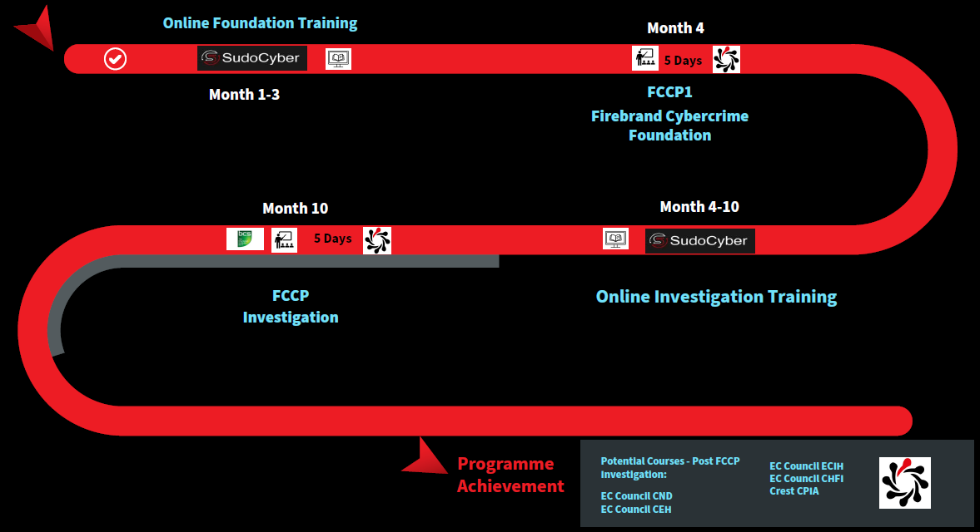
Investing in our People – Training Pathway
Notes:
Insp Gavin Mayes

Slide 17
ECU - Challenges
Government report states fraud accounts for over 40% of crime but receives less than 1% of police resources
Increasing understanding of the link between fraud and other areas of organised crime such as modern slavery and drugs
Traditional investigation - follow the money v Proactive investigation – investigate the event itself
Continued investment in ensuring we have a workforce with sufficient skills and capabilities
Data sharing - Obtaining evidence from financial institutions and in particular technology companies can be difficult and lengthy
Cross border cooperation
Notes:
DI Janie Mitchell
*** Thank you, Janine. I’ll just add that in terms pure online criminality while I think the Online Safety Act has many positives for protecting children, the associated well-publicised surged in Virtual Private Networks in which VPN providers reported seeing 1800 hundred% surge in signups, will inevitably make it harder for law enforcement to track and identify other online criminal activity, given it will make it significantly harder to trace a user's true location. This may limit future investigative opportunities leaving in a scenario where our proactive investigation are very limited and we may only be left with opportunities to following the money, or the ‘cryptocurrency’ which is the primary payment method within hacking communities. VPNs have always been a challenge for policing and they are not infallible and we can still make investigative in-roads when they drop out, but we may see less opportunities identify ‘low hanging fruit’ and those quick wins,m which have historically led to wider and more complex offending involving Organised Crime Groups.

Slide 18
ECU – Deliver Improvement & Future Goals
Reinvest recovered funds into enforcement and victim care
Expand training and investment in Cyber and Economic Crime teams
Increase Public Awareness and Digital Literacy
Notes:
DI Janie Mitchell

Slide 19

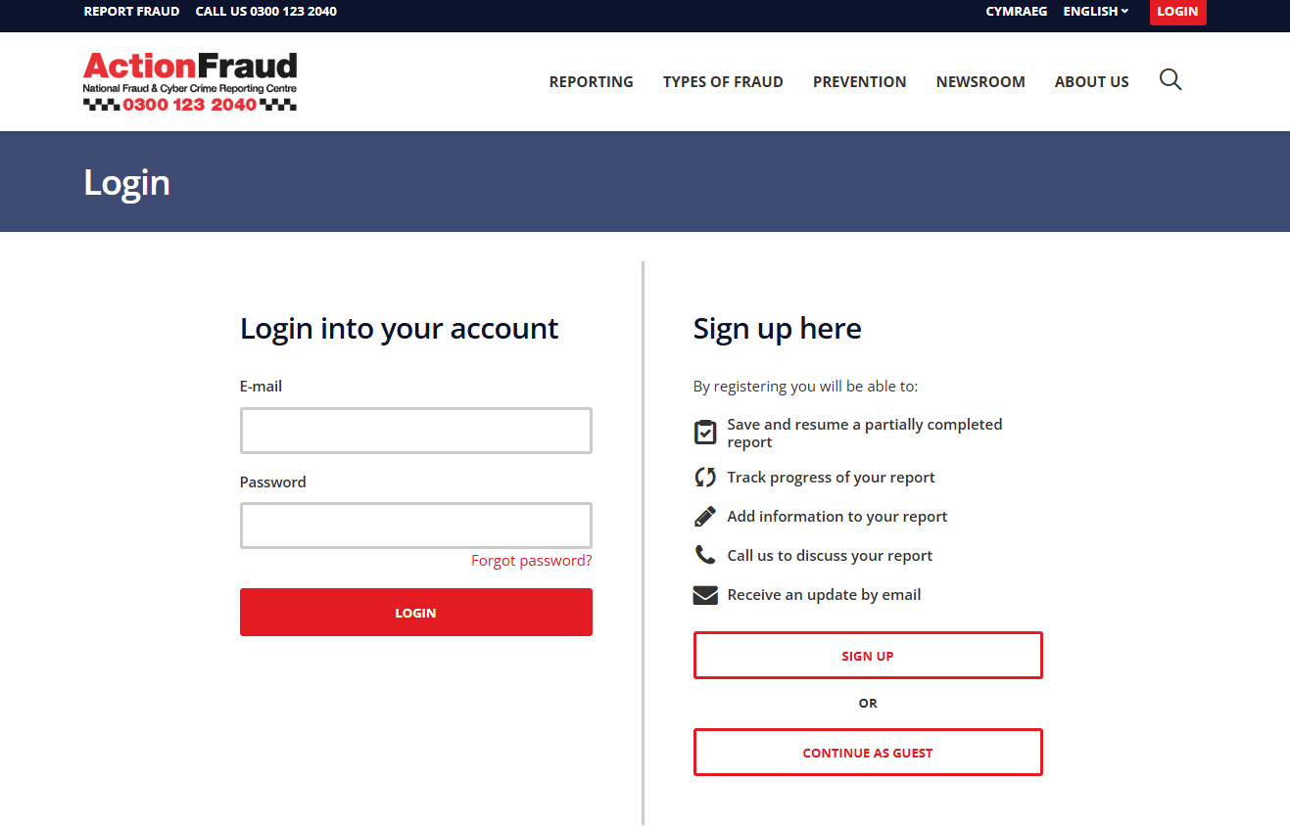
Reporting Fraud & Cybercrime
Suspicious Email Reporting Service (SERS): report@phishing.gov.uk
Notes:
DI Janie Mitchell

