Slide 1
Online Public Meeting – May 2026
HMICFRS Update
ACC Catherine Clarke
August 2023

Slide 2
Open Recommendations and Areas for Improvement (AFIs) Overview
PEEL
All PEEL 23-25 AFI completed
Other NYP specific reports
6 Recommendations and AFIs
National thematic reports
Super complaints
None Open
4 AFIs & Recs from the custody inspection
2 AFI Effectiveness of integrity arrangements
8 AFIs from PEEL Report 2025-27 (Under Assessment)
10 recommendations (Under Assessment)
24 recommendations and AFIs (Open)

Slide 3
HMICFRS Annual Performance
2025-26

Slide 4
PEEL 25-27 AFIs - Overview
Inspection fieldwork completed in November 2025
Report publication date: 22 April 2026
Work ongoing to assess the actions required to address each of the AFIs.
Question | Areas for Improvement
Q3: Using powers fairly, appropriately and with justification | 1) The force should make sure officers and staff use the new facility to record the justification for use of force
Q5: Responding to the public | 2) The force needs to reduce the number of non-emergency calls that callers abandon because they aren’t answered
 | 3) The force should improve the management and supervision of ‘priority 12’ incidents
Q6: Investigating crime | 4) The force needs to make sure it complies with the Code of Practice for Victims of Crime
Q7: Safeguarding children and adults at risk of harm | 5) The force should make sure it records all crimes committed against vulnerable victims correctly
Q9: Providing a safe and lawful custody environment | 6) The force should have effective governance and quality assurance processes to manage the safety and well-being of detainees
 | 7) The force doesn’t adequately protect the rights and entitlement of detainees who are children
 | 8) The force should effectively assess, manage and regularly review risk throughout detention and on release

Slide 5
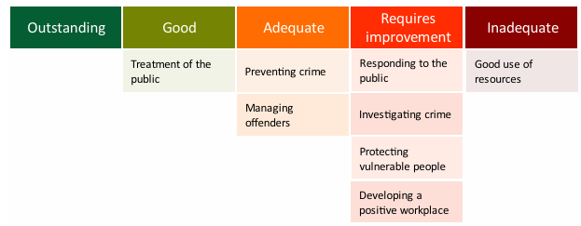
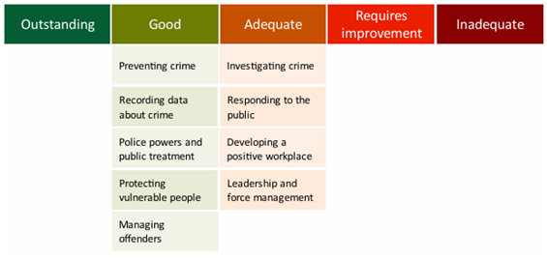
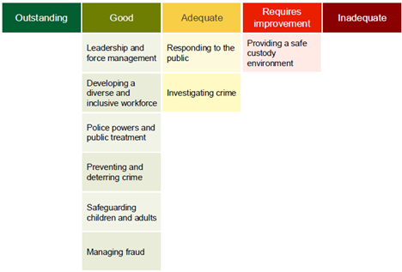
NYP PEEL Journey
2021-22
1 Good
2 Adequate
4 Requires Improvement
1 Inadequate
2023-25
5 Good
4 Adequate
2025-27
6 Good
2 Adequate
1 Requires Improvement

Slide 6
Current inspection activity
NYP were selected to be part of the HMICFRS Cybersecurity thematic inspection
Fieldwork took w/c 12 January 2026 with a hot debrief on the 19 January.
Report publication is anticipated in July.

Slide 7
Integrity Inspection
Vetting grade – Good
PSD grade (upholding the standards of professional behaviour) - Requires Improvement
ACU grade (tackling potential corruption) – Requires Improvement
No. | Area for Improvement | Activity | Status
AFI1 | The force needs to improve its processes for the collection, sharing and evaluation of organisational learning relating to the standards of professional behaviour. | PSD related organisational learning tracked & embedded within the Organisational Learning Meeting (org learning recorded on Centurion) Complaint themes and lessons learned reviewed through QPMs Quarterly IOPC Joint Oversight Meetings scrutinise complaint themes, trends, and timeliness. Forcewide dissemination of lessons learnt via NYP Weekly Bulletin and ‘The Standard’ | Closure letter ready for drafting
AFI2 | The force needs to improve the capacity and capability of the professional standards department. | Activity complete. | Closure letter submitted to HMICFRS
AFI3 | The force needs to improve the way it responds to complaints and conduct allegations. | Activity complete. | Closure letter submitted to HMICFRS
AFI4 | The force needs to understand and improve fairness and consistency within its professional standards department decision-making. | Activity complete. | Closure letter submitted to HMICFRS
AFI5 | The force should make sure it has accurate records of who has each mobile device, so that it can hold users to account for any misuse | Activity complete. | Closure letter submitted to HMICFRS
AFI6 | The force should improve how it collects, assesses, develops and investigates counter-corruption intelligence. | Implementation plan aligned to the Control Strategy priorities finalised Anti-Corruption Unit demand profiling to be revised Development and rollout of Integrity Passport ongoing Refused\Suspended Business Interests now feature at the People Intelligence meeting to ensure proactive monitoring. | Activity ongoing

Slide 8
HMICFRS Inspection Programme
Rolling programmes of policing inspections including:
  PEEL 25-27 (Completed, Report published Apr 26)
  Child protection inspections (Joint and single agency) (Dates to be confirmed by HMICFRS)
  Criminal justice joint inspections and inspection programmes (Dates to be confirmed by HMICFRS)
  Serious and organised crime (NYP Report published in December 2025)
  Integrity (NYP Report published Jan 25)
HMICFRS plan to carry out the following thematic inspections in 2024/25 and complete them in 2025/26:
  firearms licensing (report currently being drafted by HMICFRS)
  Police leadership.
HMICFRS plan to carry out or complete the following further areas over the course of their 2025-29 policing inspection programme and framework:
  the police response to knife-related crime, which will expand on the serious youth violence report;
  the efficiency and effectiveness of current arrangements that provide local, regional and national policing support services, including arrangements to meet the Strategic Policing Requirement;
  science and technology – examining the use of new and/or emerging science and technology, such as biometrics and facial recognition, to tackle crime;
  police and fire and rescue service cybersecurity (NYP were selected and fieldwork took place week commencing 12th January);
  counter-terrorism;
  Joint Emergency Services Interoperability Principles across all emergency services;
  data and analytics – including topics such as data quality, management of data, data rights analysis (the capability and role of the analyst, for example) and using science to improve the application of data; and
  retail crime and shoplifting.

