Slide 1


Online Public Meeting
Meeting Date: May 2026

Slide 2
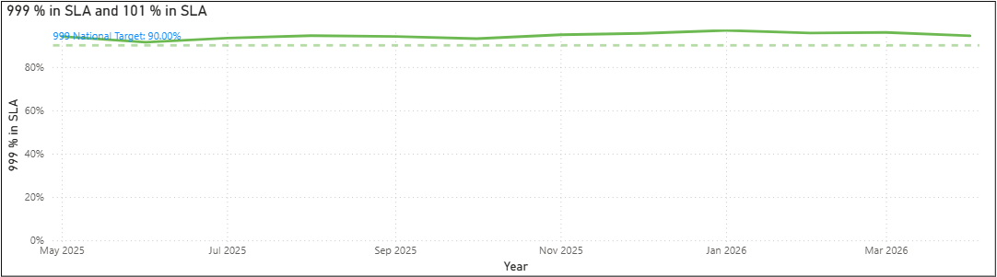
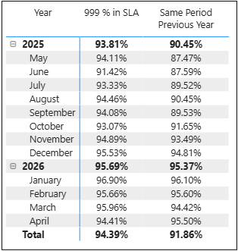


Contacting the police - 999
Call Answering – 999
7801 calls in Feb 2026
Date Period: 01st May 2025 – 30th April 2026
999 Service Level Agreement is above the national target and continuing to show high compliance.
Longest Wait 999 – April 2026
Average Answer Time 999 – April 2026

Slide 3
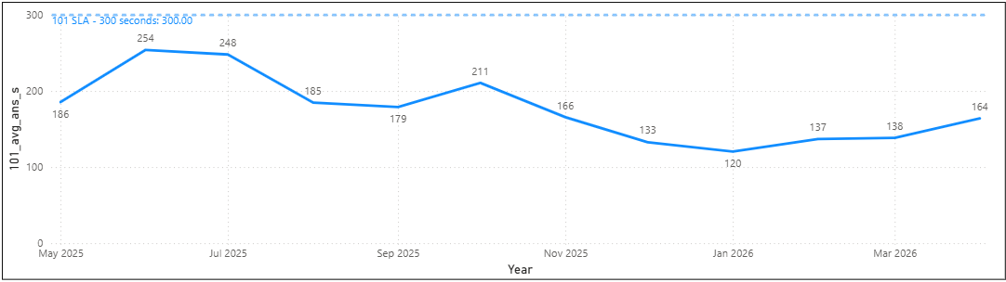
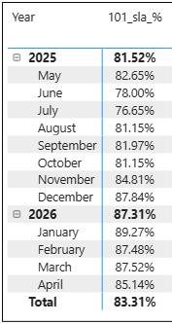

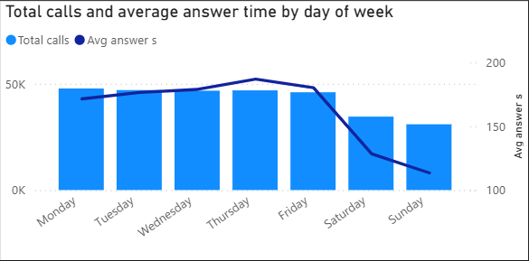
Contacting the police - 999
Call Answering –101
Date Period: 01st May 2025 – 30th April 2026
Longest Wait 101 – Feb 2026
Slight increase in average wait time in April, linked to high demand over Easter period but is anticipated in line with seasonal demand
Remains significantly under SLA of 300 seconds
Day of the week and avg answer time

Slide 4
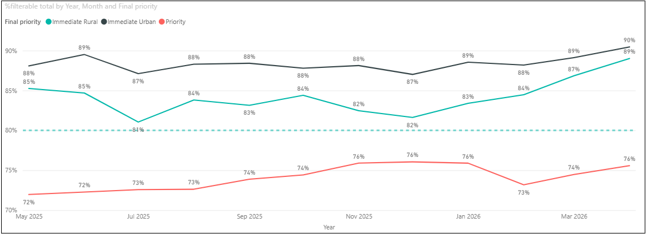
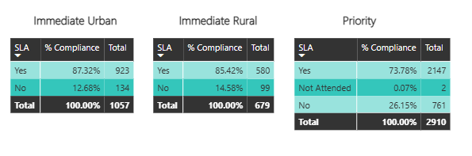
Contacting the police - 999
Response Times
Date Period: 01st May 2025 – 30th April 2026
April 2026
Response times for Immediate grade calls is above the national SLA target of 80%

Slide 5
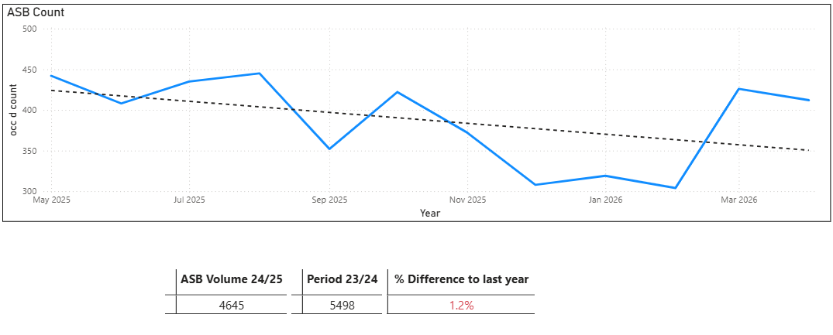
Contacting the police - 999
ASB Volumes
Date Period: 01st May 2025 – 30th April 2026
City Command Area
Coast Command Area
County Command Area
5.1% reduction
282 less incidents
3.4% increase
82 more incidents
6.2% reduction
348 less incidents

Slide 6
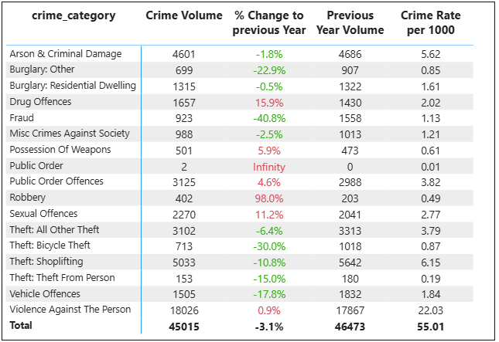
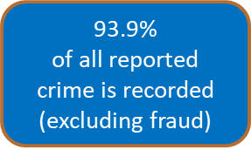
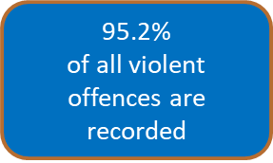
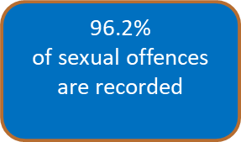
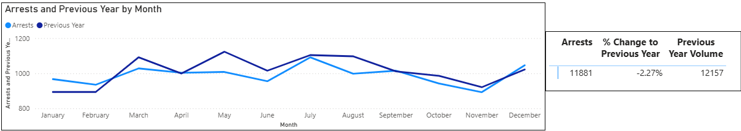
Contacting the police - 999
Crime Volumes & Arrests
Date Period: 01st May 2025 – 30th April 2026

Slide 7
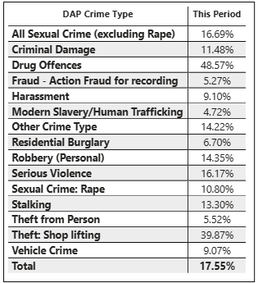
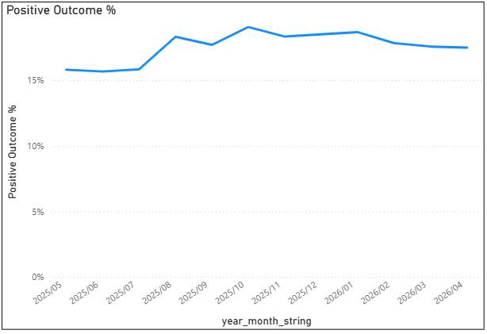
Contacting the police - 999
Crime Outcomes
Last 12 months (1st May 2025 – 30th April 2026 )
Home Office Outcome Counting Rules

Slide 8
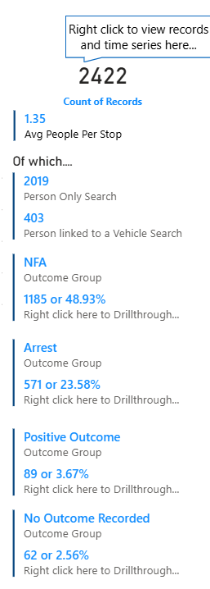
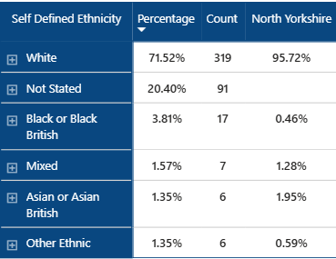
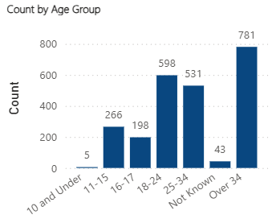
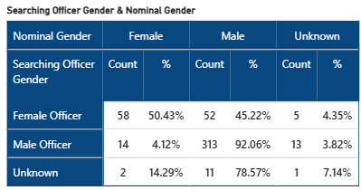
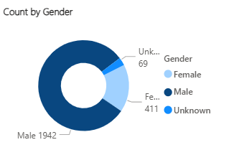
Force legitimacy (Stop Search – Ethnicity)
Date Period: 01st May 2025 – 30th April 2026
Searches on Under 18 by Officer Gender

Slide 9
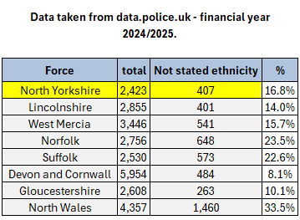
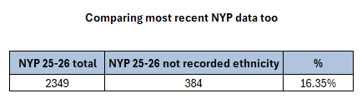
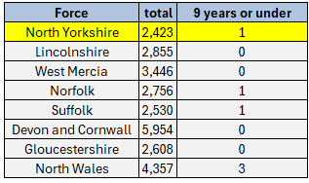

Force legitimacy (Stop Search – Ethnicity)
The above is stop search data taken from data.police.uk comparing forces total stop searches and volume of “not stated” SDE
Similar comparisons, but for ages “9 and under” taken from data.police.uk

Slide 10
Contacting the police - 999
North Yorkshire Police Workforce at 31st March 2026
These figures represent headcount and full time equivalent
Total Workforce
Neighbourhood Policing Teams
Total Workforce | Headcount | Full Time Equivalent
Police Officers | 1694 | 1679.8
PCSO's | 129 | 123.55
Police Staff | 1270 | 1153.07
Neighbourhood Policing | Headcount | Full Time Equivalent | Uplift In Year
Police Officers | 140 | 137.60 | 32
PCSO's | 110 | 104.74 | 20
Special Constables
81
Volunteers
178
Police Cadets
49

