Slide 1
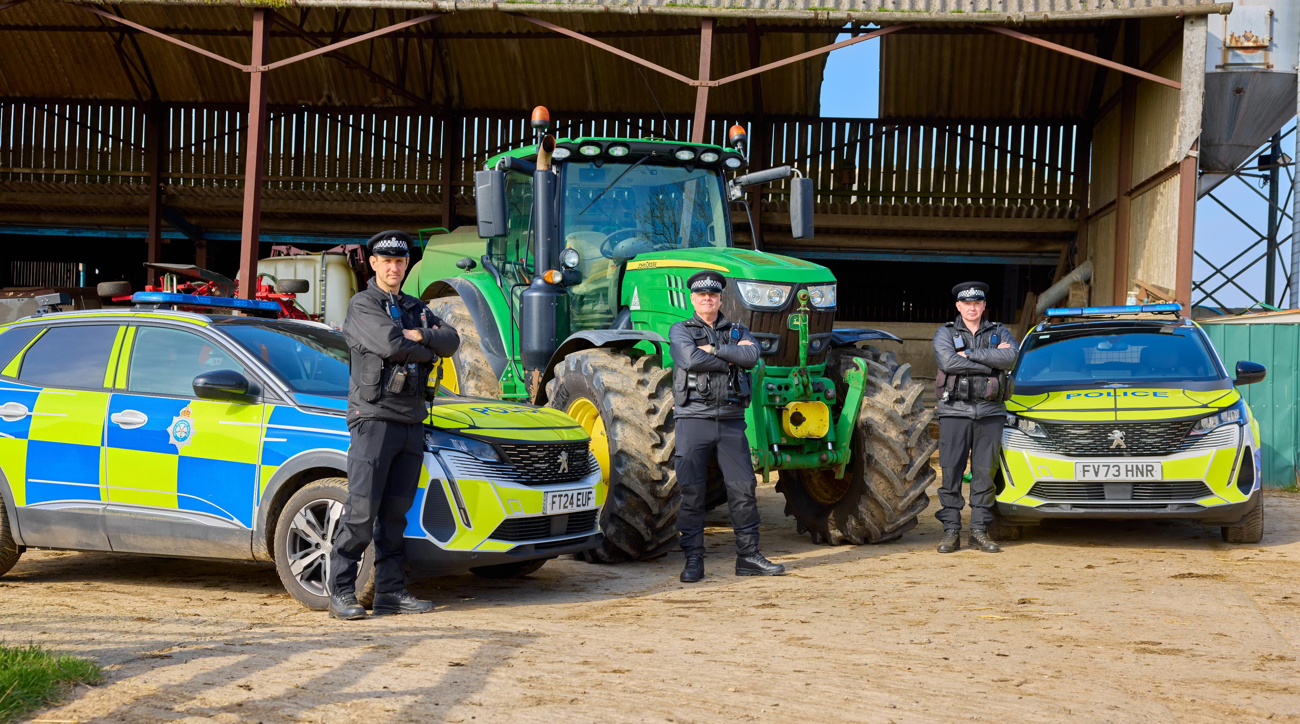
North Yorkshire Police - Rural and Wildlife crime

Slide 2
Independent measure: cost of rural crime is down
£1,476,000
NFU Mutual survey (2024)
• 22.7% fall in NYP area (greater than 16.5% national average fall).
• NYP has as long tradition of strong prevention activity and continued enforcement focus around rural crime.

Slide 3
Background and current context
Rural crime is high-harm: impacts livelihoods, wellbeing and peoples feeling of safety in isolated communities.
Wildlife crime is high-profile: national interest and affecting public confidence if not tackled robustly.
Rural businesses have seen a sharp rise in energy‑linked input costs
Fuel price shock at peak farming season
Severe financial strain on farm viability
NYP approach: prevent + pursue + protect + prepare via intelligence, patrols and partnerships across borders

Slide 4
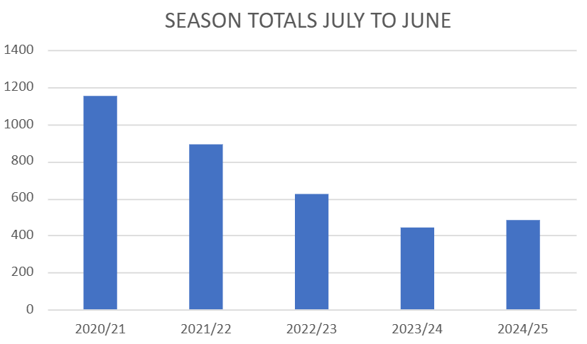
Poaching: sustained long‑term improvement
Poaching remains a key rural harm type. The long‑term direction of travel is down and the priority is to sustain this through intelligence, deterrent patrols and consistent rural engagement.

Slide 5

Livestock worrying: Operation Recall
Operational response to livestock worrying (dog attacks).
Prevention strands:
  public education/awareness;
  offender education to reduce repeat incidents.
Supported by enforcement where appropriate.
Local delivery: strong partner support and seasonal press refresh around lambing.

Slide 6
Wildlife crime: nationally significant result (Hen Harrier)
Outcome (29 Jan 2026, York Magistrates’ Court): Offender pleaded guilty; total fines/costs/surcharge £1,520.
Believed first national use of Serious Crime Act 2007 offences for bird-of-prey persecution and first successful prosecution for a Hen Harrier killing in the UK.
National recognition and a clear message that wildlife crime against protected species will be robustly pursued.

Slide 7
Organised rural offending: cross-border disruption
(case studies)
Op Monsoon: arrests and recoveries linked to rural criminals targeting farms in northern North Yorkshire; ongoing activity includes 6 offenders detained overnight and recovery of stolen vehicles/items.
Op Quarter (Craven): quad bike burglaries; partnership work has recovered quads including sophisticated cloning; investigation identified international links.
West Yorkshire collaboration: arrests and information sharing led to 11 offenders charged in a vehicle stealing/ringing conspiracy; 100+ high value stolen vehicles identified as cloned.

Slide 8
Operation Walrus:
operational impact + prevention at scale
Recover
48 GPS units recovered
Worth near £300,000
Partner
NRCU + neighbouring forces
NFU + dealerships
Prevent
903+ farms signed up
4,925 SelectaDNA kits issued
Notes:
.

Slide 9
Forward look: sustain gains and tackle emerging threats
Emerging/related threat: Oil thefts – 34 thefts recorded; heating oil tank thefts peaked overnight/weekends; one offender arrested with intelligence links to an eastern European OCG committing fuel theft nationally.

