Slide 1
Deliberate Outdoor/Secondary Fires
Online Public Meeting - 14/09/2026

Slide 2
Assurance Presentation
What national and local trends, seasonal peaks, hotspots and emerging risks are evident?
How does incident data, intelligence and partner insight identify repeat areas?
How does the Service work with key stakeholders?
How does this support targeted prevention, engagement, education and early interventions?
Case study of recent collaborative work.
Monitoring and measuring performance – how performance and outcomes are monitored and evaluated to support organisational learning.

Slide 3
Definition and Terminology
Primary Fire
A fire where one or more of the following applies:
Any fire in a non-derelict building.
Any fire in a non-derelict vehicle.
Any fire in specified outdoor structures.
Any fire involving a casualty, fatality, rescue or escape.
Any fire attended by five or more pumping appliances.
Secondary Fire (Focus of this presentation)
A reportable fire that:
Is not a chimney fire.
Does not meet the criteria for a primary fire.
Typically involves grass, rubbish, refuse, skips, heathland or similar materials.
Has no casualties or rescues.
Is attended by four or fewer pumping appliances
Accidental ignition: Fire initiation without intent to cause a fire.
Deliberate ignition: Fire initiation resulting from an intentional act to cause a fire.
"Fire in the open/Outdoor" is an incident type/location description, not a reportable classification.

Slide 4
National & Local Trends
In the financial year 2025/2026, nationally Fire and Rescue Services attended 170,597 fires, an increase of 19% compared with the previous year.
102,549 Secondary Fires, an increase of 30% compared with the previous year
71,520 Deliberate Fires in comparison to 61,824 the year before, which is a 16% increase
NYFRS attended 792 Deliberate Fires in 2025/2026, a 27% increase compared with the previous year.
Although deliberate fires attended by NYFRS increased from 622 in 2024/2025 to 792 in 2025/2026, levels remain significantly lower than the national average - around 23% below.
Notes:
https://www.gov.uk/government/statistics/fire-and-rescue-incident-statistics-year-ending-march-2026/fire-and-rescue-incident-statistics-year-ending-march-2026--2#figure2.1
Fire incidents attended are broadly categorised as primary, secondary or chimney fires, depending on the location, severity and risk levels of the fire, and on the scale of response needed from FRSs to contain them.
Primary firesThose that meet at least 1 of the following criteria: (i) occurred in a (non-derelict) building, vehicle or outdoor structure (ii) involved a fatality, casualty or rescue (iii) were attended by 5 or more pumping appliances.
Secondary firesGenerally small outdoor fires, not involving people or property.
Chimney firesIn (non-industrial) buildings where the flame was contained within the chimney structure.

Slide 5
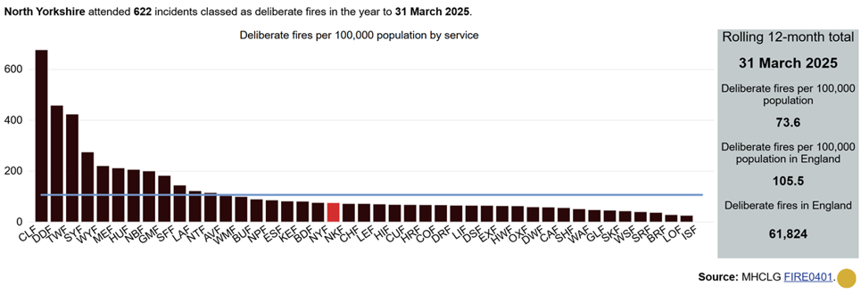
National Statistics – Deliberate Fires Attended
Year to 31 March 2025

Slide 6
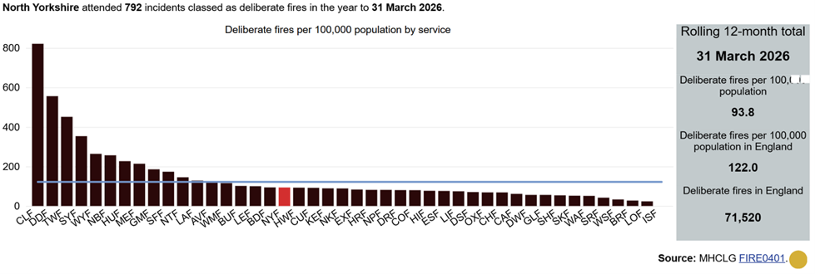
National Statistics – Deliberate Fires Attended
Year to 31 March 2026

Slide 7
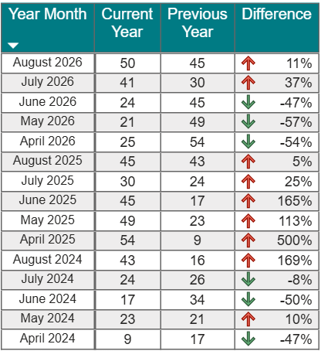
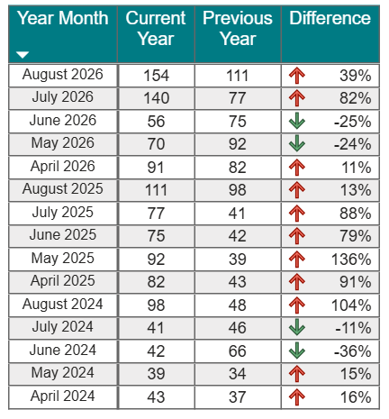
Change from summer 2024 to summer 2026 across the UK
Secondary Accidental
Secondary Deliberate
+2.1°C
Mean summer temperature rose from 14.4°C to 16.5°C.
warmer
overall
−19%
Summer rainfall fell by 45.9 mm, from 241.3 mm to 195.4 mm.
less
rainfall
−65%
July rainfall fell from 82.4 mm in 2024 to 28.9 mm in 2026.
less rain
in July
2
Notes:
In 2026, July and August were drier and hotter, although June was wetter than in 2025, which saw a considerable drop in fires in comparison to the previous year.

Slide 8
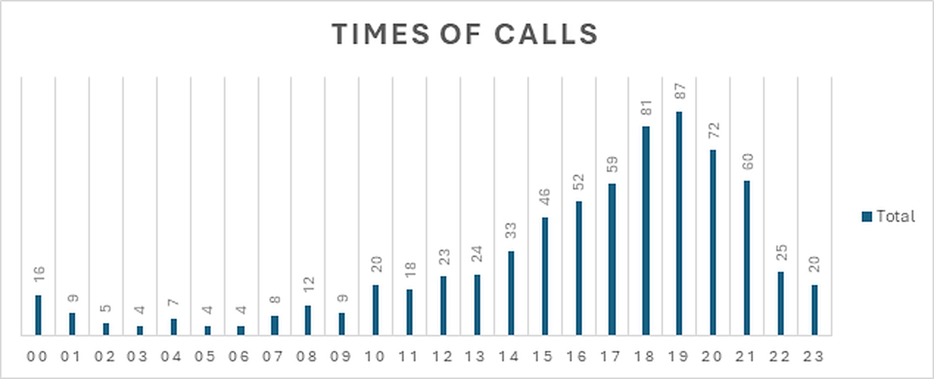
Incident Data and Trends
Time of day
Incidents per day
Monday | 96
Tuesday | 97
Wednesday | 93
Thursday | 85
Friday | 93
Saturday | 124
Sunday | 110
Based upon Fires in the Open 2025/26

Slide 9
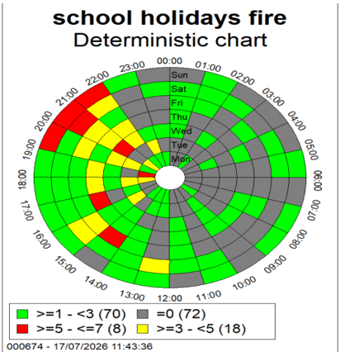
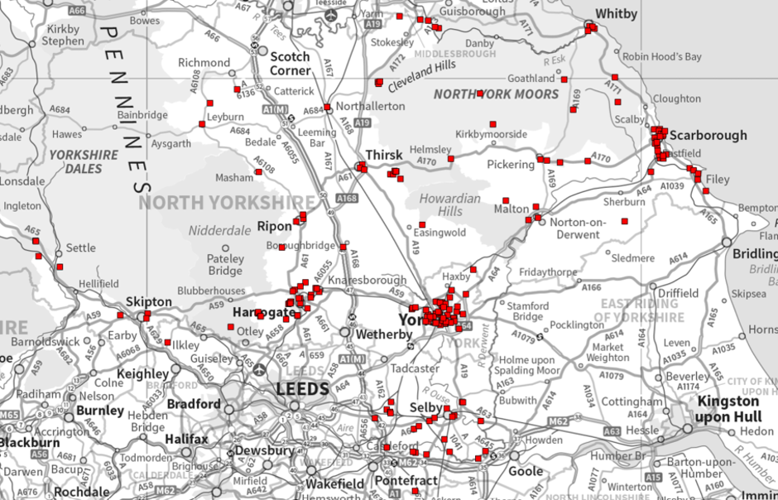
Incident Data and Trends
The Service routinely analyses:
Location of incidents and geographic hotspots
Repeat incidents at the same locations
Incident type (e.g. grass, refuse, bin and other outdoor fires)
Date and time of occurrence
Seasonal and weather-related trends
Operational demand and resource impacts
This information helps identify areas experiencing increased levels of activity and locations where repeat incidents are occurring.

Slide 10
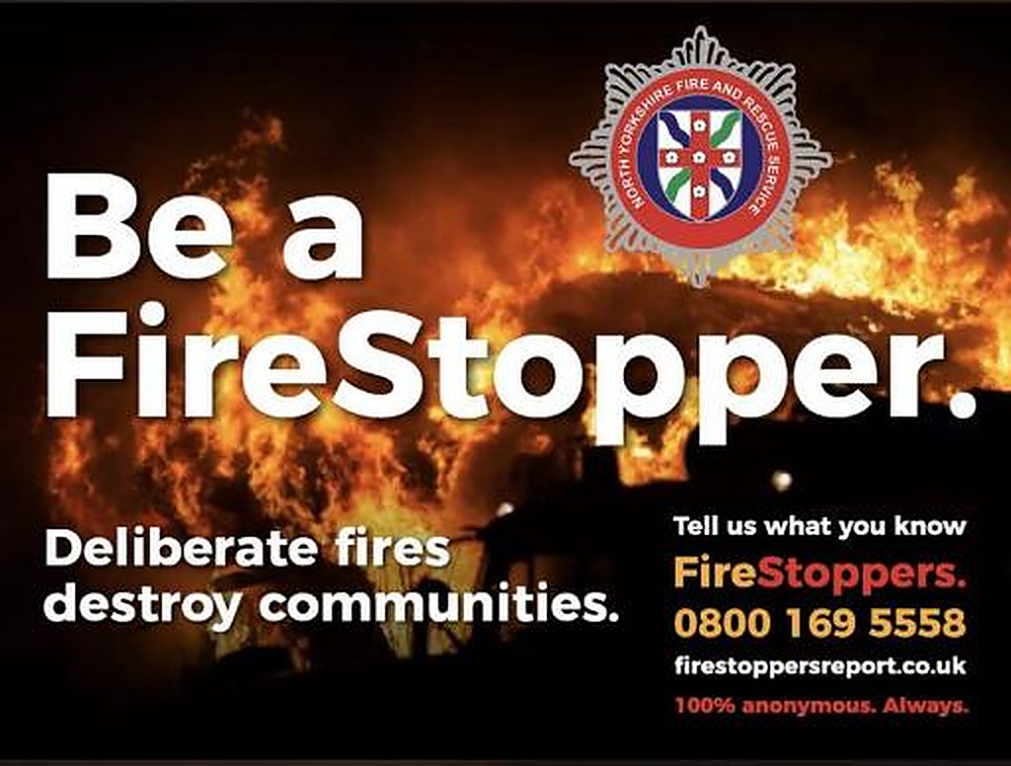
Local Intelligence
Information is also gathered through:
Local knowledge from stations and district teams
Community reports and concerns
Multi agency meetings
Fire Stoppers
Emerging issues identified whilst undertaking prevention activity in the community.
This provides context to incident data and helps the Service understand local factors that may be contributing to community safety risks.

Slide 11
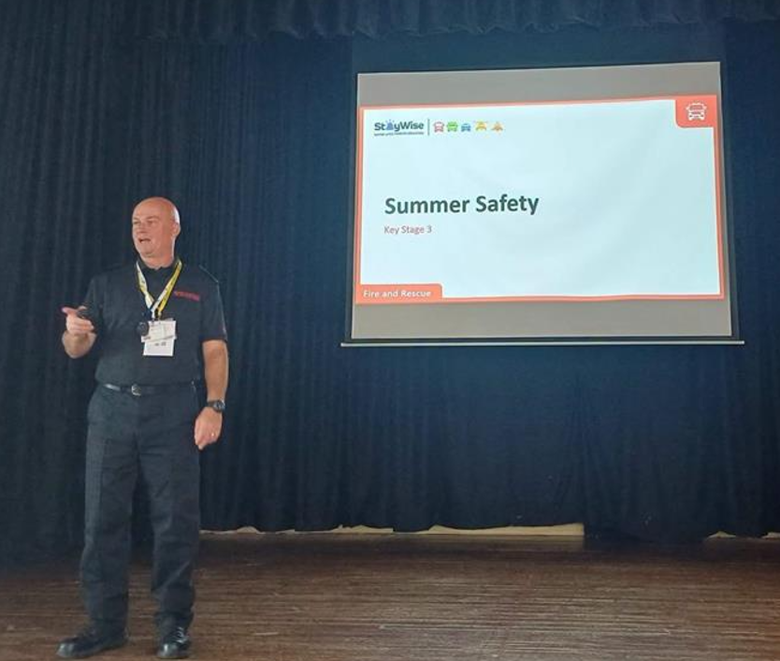
Partnership Information
The Service works with partners to develop a broader understanding of risk, including information from:
North Yorkshire Police
Community Safety Partnerships
Local Authorities
Youth Justice Services
Schools and education providers
Youth and community services
Housing providers
Information sharing arrangements help identify repeat locations, emerging issues and opportunities for joint intervention.

Slide 12
Partnership Working to Reduce Deliberate Fire Setting
Share information relating to repeat locations and emerging issues.
Identify links between deliberate fires and wider community safety concerns.
Support joint problem-solving approaches within hotspot locations.
Contribute to multi-agency responses where deliberate fire-setting forms part of broader Anti-Social Behaviour patterns.
Work with Community Safety Hubs.
Joint Anti-Social Behaviour Fire Meetings with North Yorkshire Police at Strategic and Tactical level.
Notes:
Reducing deliberate fire-setting requires a coordinated multi-agency approach. NYFRS works closely with North Yorkshire Police, local authorities, Community Safety Partnerships, schools, youth services and other agencies to identify risks, share intelligence and deliver targeted interventions.

Slide 13
How working with partners delivers better outcomes
Partnership working enables agencies to:
Develop a shared understanding of local risks.
Identify repeat demand and emerging trends.
Coordinate interventions and avoid duplication.
Focus resources on communities experiencing the greatest impact.
Address underlying causes rather than responding solely to incidents.

Slide 14
How this informs our activity
The Early Intervention and Prevention Triangle
Specialist
Prevention
Complex Interventions
High Risk Individuals
Multi Agency Approach
Safeguarding & Specialist Support
Three tiers to our Early Intervention and Prevention Activities:
Universal
Targeted
Specialist
Increased Risk & Need
Targeted Prevention
At Risk Groups
Home Fire Safety Visits
Focused Road & Water Safety
Post Incident Engagement
Education
Universal
Safety Campaigns
Community Events
General Advice
Online Home Fire Safety Checks

Slide 15
How this informs our activity
Target community safety campaigns – social media
Deliver seasonal prevention messaging – social media wildfire
Focus activity on areas experiencing repeat incidents – Fire Stoppers, site visits, blue routes
Support local problem-solving initiatives – Op Fire Safe
Youth engagement activity – developing resilience programme
School based education programmes – incorporated into our education syllabus
Community reassurance activity – Fire Stoppers, blue routes, attendance at summer event
Multi-agency problem-solving plans being utilised
Notes:
The Service adopts an intelligence-led approach to reducing deliberate outdoor fires. By combining incident data with information from local communities and partner agencies, NYFRS is able to identify trends, understand community impacts and target prevention, youth engagement and partnership activity towards the areas of greatest risk.

Slide 16
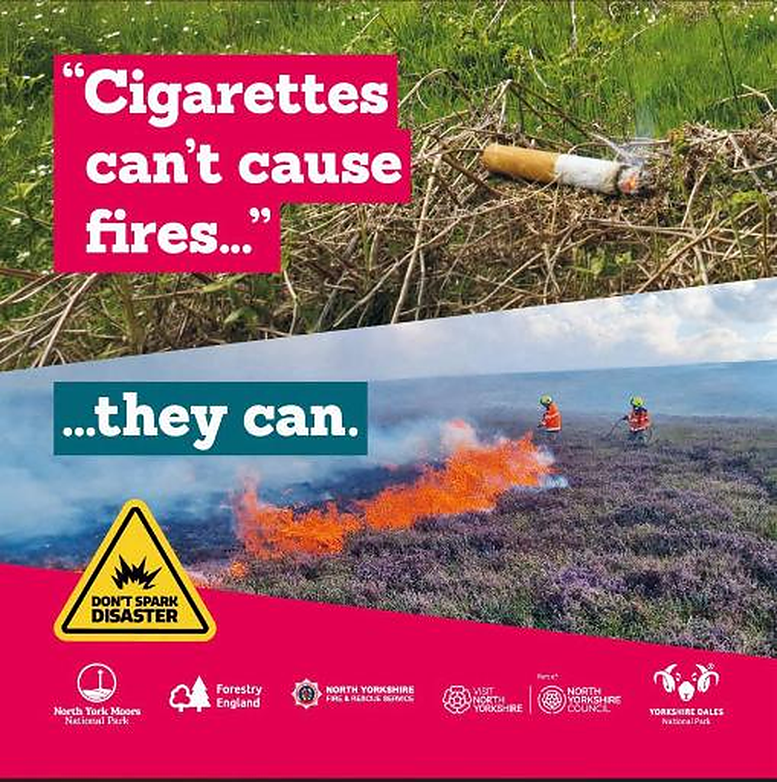
Universal Education Advice
Since May 2026, we've published 194 social media posts across these campaign areas and wider fire safety and warn and inform messages. The Wildfire, Water and Deliberate Fire campaigns have a combined reach of 693,193 across Facebook and Instagram.
Campaign breakdown
Deliberate Fires: 7 posts, reaching 42,920 people
Wildfires: 40 posts, reaching 384,993 people

Slide 17
Case Study - Operation Firesafe
Purpose
NYFRS and North Yorkshire Police (NYP) responded to an increase in deliberate small fires and youth-related Anti-Social Behaviour across York.
Incidents were concentrated in parks, open spaces and areas near residential communities, creating risk, environmental damage and resident concern.
Partnership approach
NYFRS, NYP Neighbourhood teams, local schools and the Community Safety Partnership worked together.
Partners shared intelligence from control rooms, schools and community reports to identify hotspots and target activity.

Slide 18
Case Study - Operation Firesafe
Key interventions
School and youth workshops on fire safety, arson consequences and community impact.
Joint “blue route” patrols in hotspot areas during evenings and weekends.
Early intervention through Firesafe referrals, one-to-one sessions and family support.
Community messaging through schools, social media and local media.
Collaboration
Increased Firesafe referrals from NYP.
Stronger joint working, communication and information sharing between NYFRS, NYP, schools and community hubs.
Improved engagement with CYP partnership meetings, including MAPS and MACE.
Local reduction in ASB Fires in the area.

Slide 19
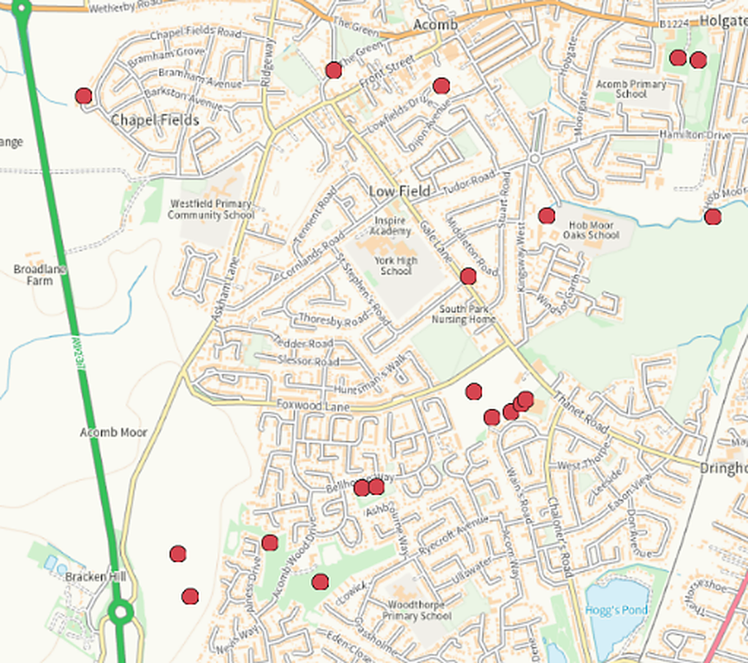
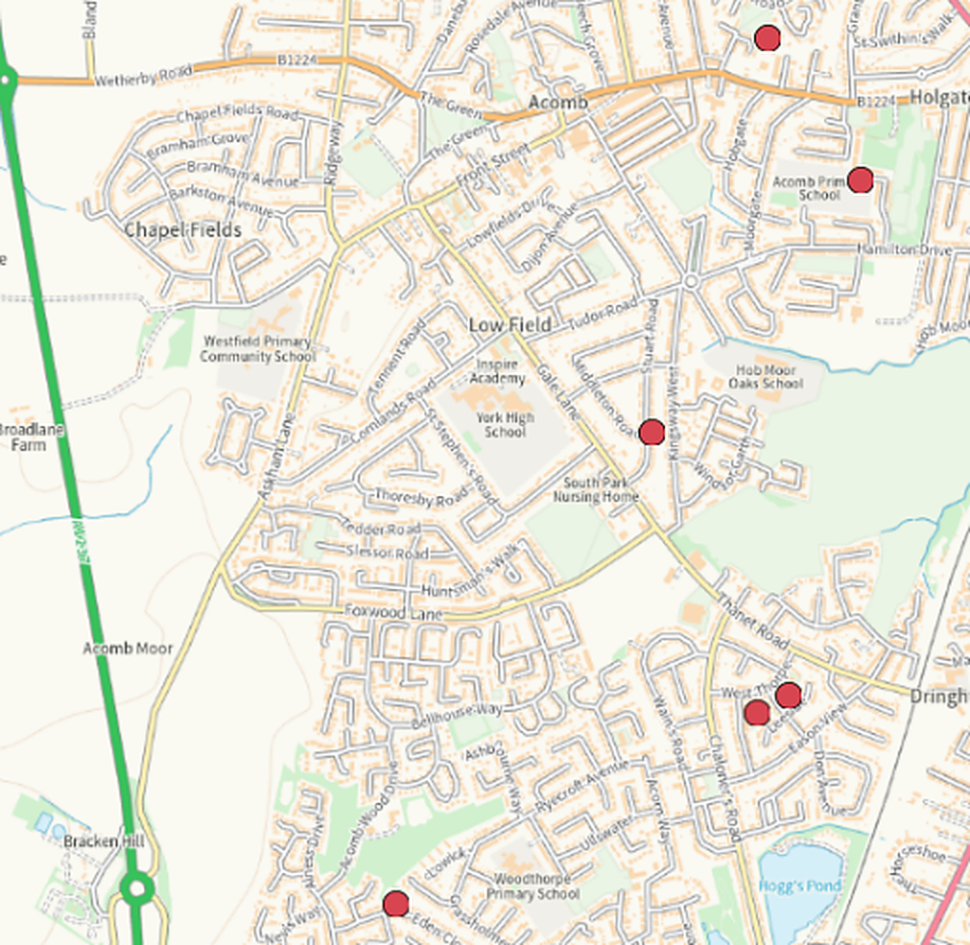
Reduction in Incidents July vs Aug 2026
July 26
August 26

Slide 20
Outcomes
Reduction in deliberate fires in hotspot areas.
Fewer preventable incidents requiring emergency service attendance.
From noticeable reduction, residents feeling safer and more reassured.
Young people gaining a better understanding of fire risk, consequences and impact on others.
Key learning
Combining education, prevention, visibility and early intervention is more effective than responding to incidents alone.
Strong collaboration between NYFRS, NYP and schools helped address root causes while improving community safety

Slide 21
Monitoring & Measuring Performance
The Service monitors deliberate outdoor fires through a combination of operational performance data, intelligence and partnership information.
How?
Prevention Team undertake a monthly and quarterly analysis of incident data to identify trends, hotspots and repeat locations.
Ongoing sharing of intelligence with Community Safety Partnerships and North Yorkshire Police.
Review of seasonal trends and periods of heightened risk to inform our delivery packages.
Monitoring outcomes from targeted prevention campaigns and interventions.
Joint NYFRS/NYP Strategic and Tactical Anti-Social Fires Meetings.
Reporting patterns, trends and activities in the Community Risk and Resilience Meeting.
Deputy Mayor/Combined Authority convening multi agency meeting to ensure effective collaboration was being undertaken.

