Slide 1
Online Public Meeting – October 2026
HMICFRS Update
DCC Scott Bisset
August 2023

Slide 2
Open Recommendations and Areas for Improvement (AFIs) Overview
PEEL
8 AFIs from PEEL Report 2025-27
Other NYP specific reports
8 Recommendations and AFIs
National thematic reports
Super complaints
None Open
18 recommendations (Under Assessment)
18 recommendations and AFIs (Open)
3 AFIs from the YaTH regional response to serious organised crime

Slide 3
HMICFRS Performance
2025 to date

Slide 4
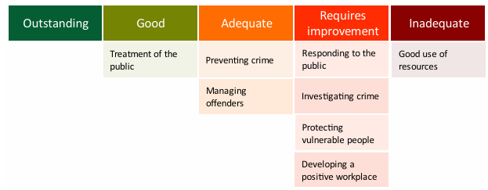
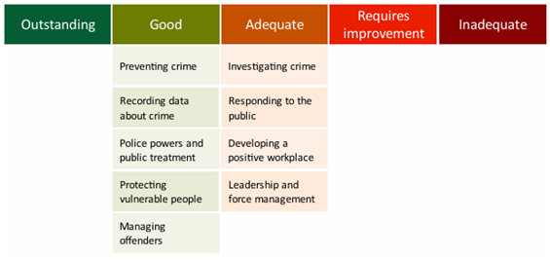
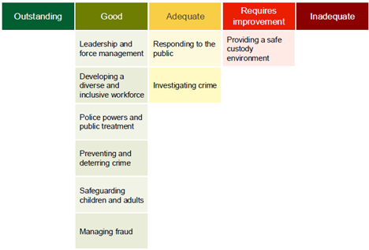
NYP PEEL Journey
2021-22
1 Good
2 Adequate
4 Requires Improvement
1 Inadequate
2023-25
5 Good
4 Adequate
2025-27
6 Good
2 Adequate
1 Requires Improvement
Notes:
.

Slide 5
PEEL AFI - Overview
8 PEEL AFIs
No. | Area for Improvement | Status | No. actions o/s | Date due
AFI1 | The force should make sure officers and staff use the new facility to record the justification for use of force | Improvement in progress | 2 out of 2 | Nov 26
AFI2 | The force needs to reduce the number of non-emergency calls that callers abandon because they aren’t answered | Closure letter being drafted | None | Sep 26
AFI3 | The force should improve the management and supervision of ‘priority 12’ incidents | Improvement in progress | 2 out of 4 | Nov 26
AFI4 | The force needs to make sure it complies with the Code of Practice for Victims of Crime | Improvement in progress | 7 out of 8 | Mar 27
AFI5 | The force should make sure it records all crimes committed against vulnerable victims correctly | Improvement in progress | 4 out of 4 | Sep 26
AFI6 | The force should have effective governance and quality assurance processes to manage the safety and well-being of detainees | Improvement in progress | 6 out of 6 | Apr 27
AFI7 | The force doesn’t adequately protect the rights and entitlement of detainees who are children | Improvement in progress | 6 out of 6 | Mar 27
AFI8 | The force should effectively assess, manage and regularly review risk throughout detention and on release | Improvement in progress | 5 out of 5 | Dec 26

Slide 6
PEEL AFI Update
AFI 1 | The force should make sure officers and staff use the new facility to record the justification for use of force
In Progress | Enhance the Champion cohort by August 2026
In Progress | Extra assurance work is to be conducted by the Inspection and Strategic Planning Team to check compliance to recording practises.
AFI 2 | The force needs to reduce the number of non-emergency calls that callers abandon because they aren’t answered
Complete | Review the reporting mechanism of all 101 abandonment calls and include measures within the Quarterly Performance Meeting packs.
Complete | Evaluate channel shift tracking opportunities
AFI 3 | The force should improve the management and supervision of ‘priority 12’ incidents
Complete | Update Public Assistance Grading and Dispatch Policy.
In Progress | Refine the grading criteria of calls to reduce P12s
In Progress | Ensure team managers are making good use of the STORM performance monitoring. To be tracked through Team Performance Meetings
Complete | Implement daily tracking of call backs and the reapplication of the risk assessment of P12s

Slide 7
PEEL AFI Update
AFI 4 | The force needs to make sure it complies with the Code of Practice for Victims of Crime
In Progress | Develop automated reporting ability that services force performance and national ADR return set against the 12 rights of the Victims' Code and the new MoJ measures.
In Progress | Form force wide membership operational victim service improvement working group to focus on driving continuous improvements.
In Progress | Once the MoJ metrics are released review and revise the VNA template to reflect national requirements. explore how we service qualitative assurance, liaise with Learning and Development to ensure any revised requirements are covered in officer training and consider re-establishing the Victims Code Performance Working Group and Action Plan to drive improvements
In Progress | Liaise with Learning and Development to ensure initial training and Op Crystal / Development Days cover Enhanced Rights to promote awareness and drive performance.
In Progress | Explore progress nationally through Minerva regarding how to better capture VNA requirements on Niche.
In Progress | Consider opportunities around victim engagement to capture confidence in NYP services and compliance with victim code. Understand national MOJ commissioning of victim survey landscape for DA matters and wider crime types currently under development.
Complete | Evolution of the Victim & Witness Services Sergeant role to include management of the Witness Care Team. This will provide support to understand and manage the increasing demand.
In Progress | Victims and Courts Act 2026 gained Royal Ascent in April 2026, consideration to be given to a force wide communications strategy to brief the workforce

Slide 8
PEEL AFI Update
AFI 5 | The force should make sure it records all crimes committed against vulnerable victims correctly
In Progress | An input to be delivered to the Vulnerability Assessment Team officers and staff who attend partnership meetings in the course of their duties from Deputy Crime and Incident Registrar.
In Progress | Wider comms will be circulated highlighting the need to fully scrutinise third party information that may require a crime report .
In Progress | A request will be made to the Safeguarding Assurance Team to conduct an audit focussing on third party safeguarding reports once these actions have been carried out.
In Progress | Amend Niche templates that are completed at the conclusion of strategy meetings and Initial Child Protection Conferences (ICPC) to explicitly highlight the requirement to record any crimes that were discussed within the meeting within 24 hours.

Slide 9
PEEL AFI Update
AFI 6 | The force should have effective governance and quality assurance processes to manage the safety and well-being of detainees
In Progress | Custody and Business Insight Teams to scope a phased implementation plan for the redesign of the QA product. This data then requires embedding into Team Performance Meetings and Custody Strategy Group.
In Progress | Implement the phased plan aligning the performance framework to APP and HMICFRS requirements and ensure this is embedded throughout custody, supported by standard operating procedures and automation where possible. CPD events in July 2026 should be used to focus on performance requirements.
In Progress | A programme of local thematic inspections to be put in place across all custody suites aligned to HMIC & APP to provide independent oversight.
In Progress | Custody Standing Operating Procedure Handbook to be developed to ensure consistency and corpocracy across all custody suites. Roll out should be supported by a communications plan and incorporated within the Custody course in November 2026.
In Progress | Commission reality testing / assurance activity to ensure provide assurance across all suites in respect of; compliance with APP and HMIC requirements, awareness and embedding of SOPs, consistency of QA
In Progress | Consideration to be given to the review of the operating model to support the governance, oversight and independent scrutiny of custody.

Slide 10
PEEL AFI Update
AFI 7 | The force doesn’t adequately protect the rights and entitlement of detainees who are children
In Progress | Develop AA performance framework and report through internal governance and external partner forums such as Youth Justice Boards and Safeguarding Boards to drive continuous improvement.
In Progress | Develop internal standing operating procedure for AA provision for children and vulnerable adults and ensure that this is appropriately communicated and understood across custody and partners.
In Progress | Work collaboratively with the Deputy Mayor's office and local authorities to review and improve AA provision for both vulnerable adults and children. Consider the potential commissioning of additional services to strengthen the provision.
In Progress | A communications strategy shall be developed to support any change in service to AA provision once this has been reviewed and approved. Share learning through CPD.
In Progress | Commission reality testing to check understanding and ensure communications to custody staff in relation to the process around the use of AA provision for children and vulnerable adults.
In Progress | Through the redesigned QA process ensure that the force scrutinises and ensures that where a female officer is allocated to a female child that evidence of contact / discussion is recorded.

Slide 11
PEEL AFI Update
AFI 8 | The force should effectively assess, manage and regularly review risk throughout detention and on release
In Progress | Consider adoption of software which is being suggested as a national custody risk assessment framework.
In Progress | Undertake a review to refresh risk assessment processes and procedures to ensure local SOPs around risk are robust and bespoke where required. To include; observation levels, pre-release risk assessment, when and how to obtain a PND check with fallback being FCR
In Progress | Ensure that there is a SOP in relation to how Police National Database (PND) is should be used in the custody environment in line with APP and commission reality testing to check understanding.
In Progress | Implement PODS in custody which will allow softer restraint tactics to be utilised. Officer safety trainers to receive training so that these can be rolled out.
In Progress | Review the findings of the 100% strip search QA implemented during the inspection to determine outcome and evaluate the benefits.

Slide 12
An inspection of the Yorkshire and the Humber regional response to Serious and Organised Crime
NYP grade – Adequate
No. | Area for Improvement | Activity | Status
AFI1 | The Yorkshire and Humber Regional Organised Crime Unit and its constituent forces should improve how they work together to tackle serious and organised crime. The Yorkshire and Humber Regional Organised Crime Unit (YHROCU), and its constituent forces, should improve: • the quality and consistency of 4P plans; • how they record disruption activity on the agency and partner management information system (APMIS); and • the recording of unmet demand on APMIS. | The force utilises the national 4P plan template and these are scrutinised through force governance; the force is seeking to improve this process through the implementation of the National 4P App. Work is ongoing to improve the recording of disruptions across all aspects of 4P’s. | Activity ongoing – target delivery date is the end of September 2026
AFI2 | The Yorkshire and Humber Regional Organised Crime Unit and its constituent forces should improve how the region procures and uses technical surveillance equipment | Regional governance now in place regarding procurement. | Closure letter completed
AFI3 | North Yorkshire Police should improve how it accesses serious and organised crime data from partners | The force is working with partners to improve access to additional data which will inform its SOC local profiles. | Activity ongoing – target delivery date is the end of September 2026
AFI4 | North Yorkshire Police should improve how it manages serious and organised crime offenders | The force is developing its understanding regarding any potential challenges to the successful application for Serious Crime Prevention Orders (SCPOs) The publication of communication and training to the workforce regarding thresholds for SCPOs The realignment of SCPO management within the Safeguarding function. | Closure letter being drafted

Slide 13
HMICFRS Inspection Programme
Rolling programmes of policing inspections including:
  PEEL 25-27 (Completed, Report published Apr 26)
  Child protection inspections (Joint and single agency) (Dates to be confirmed by HMICFRS)
  Criminal justice joint inspections and inspection programmes (Dates to be confirmed by HMICFRS)
  Serious and organised crime (NYP Report published in December 2025)
  Integrity (NYP Report published Jan 25)
HMICFRS plan to carry out or complete the following further areas over the course of their 2025-29 policing inspection programme and framework:
  the police response to knife-related crime, which will expand on the serious youth violence report;
  the efficiency and effectiveness of current arrangements that provide local, regional and national policing support services, including arrangements to meet the Strategic Policing Requirement;
  science and technology – examining the use of new and/or emerging science and technology, such as biometrics and facial recognition, to tackle crime;
  police and fire and rescue service cybersecurity (NYP were selected and fieldwork took place week commencing 12th January);
  counter-terrorism;
  Joint Emergency Services Interoperability Principles across all emergency services;
  data and analytics – including topics such as data quality, management of data, data rights analysis (the capability and role of the analyst, for example) and using science to improve the application of data; and
  retail crime and shoplifting.

