Slide 1



Online Public Meeting
Meeting Date: October 2026

Slide 2
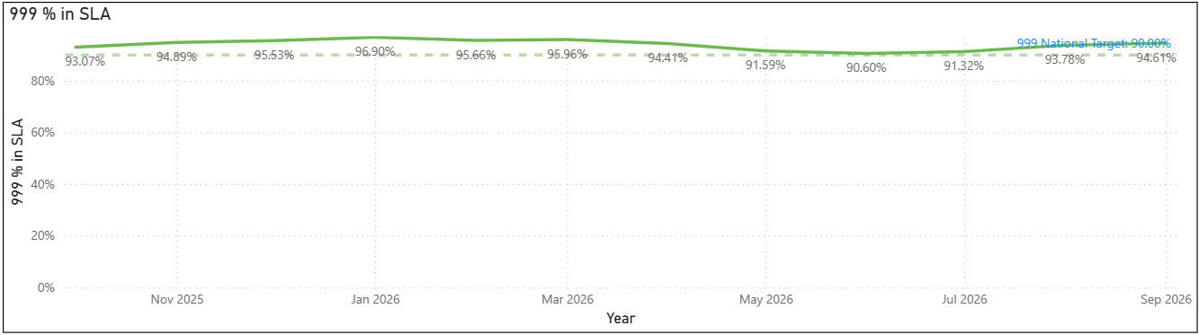
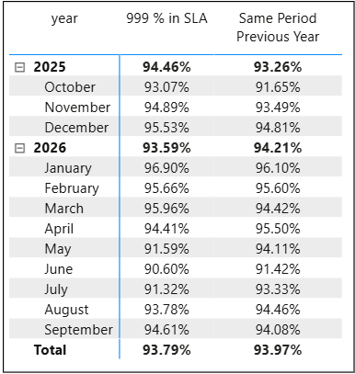


Contacting the police - 999
Call Answering – 999
Date Period: 01st October 2025 – 30th September 2026
999 Service Level Agreement is above the national target and continuing to show high compliance.
999 demand continues to increase with 6968 more calls this financial year to date compared to same period last year
Longest Wait 999 – Sept 2026
Average Answer Time 999 – Sept 2026
System outage in FCR during system maintenance – calls picked up by Humberside and recontacted by NYP – system defaults to 6 mins

Slide 3
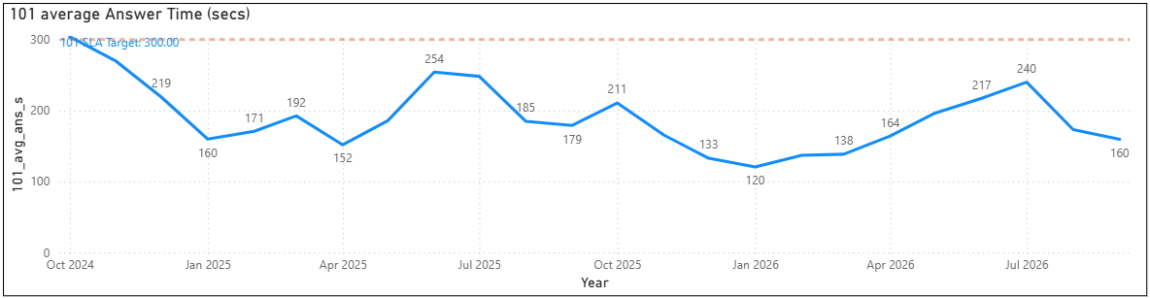
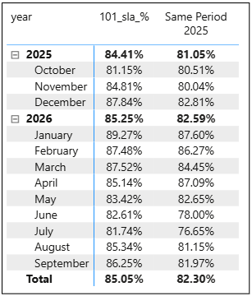

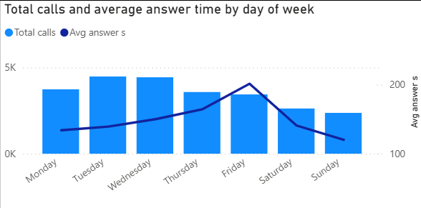

Contacting the police - 999
Call Answering –101
Date Period: 01st Oct 2024 – 30th Sept 2026
101 call answer times continue to be stable, with seasonality a significant impact during the summer months which was anticipated and staffing levels increased.
Longest Wait 101 – Sept 2026
Day of the week and avg answer time

Slide 4
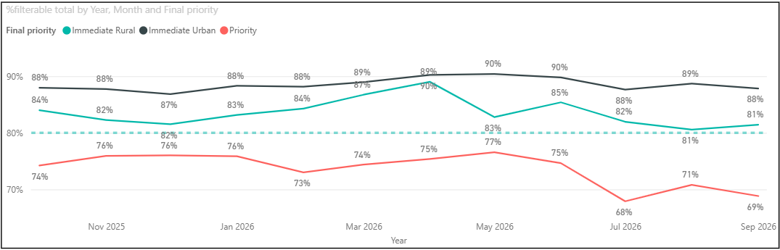
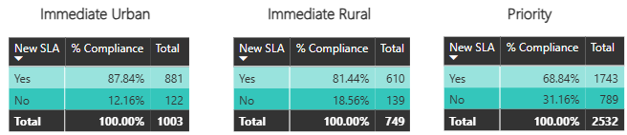
Contacting the police - 999
Response Times
Date Period: 01st October 2025 – 30th September 2026
September 2026
Response times for Immediate grade calls is above the national SLA target of 80%

Slide 5
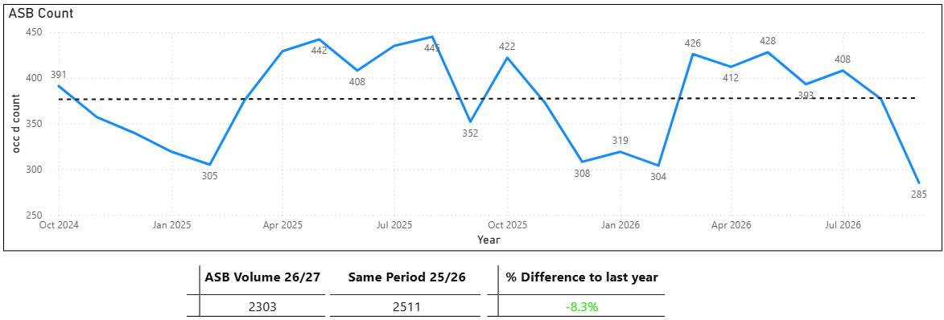
Contacting the police - 999
ASB Volumes
Date Period: 01st October 2024 – 30th September 2026
City Command Area
+3.2%
32 more reports
Coast Command Area
-13.3%
102 less reports
County Command Area
-18.6%
138 less reports
ASB Incidents have slightly decreased year on year.
Effective Problem-Solving involving community partners is driving reductions in problematic areas

Slide 6
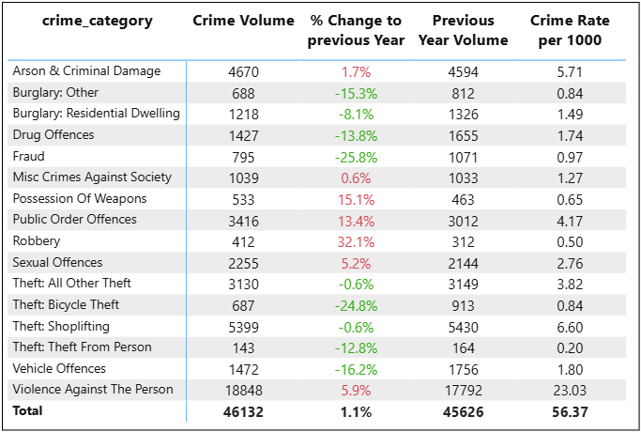
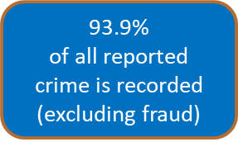
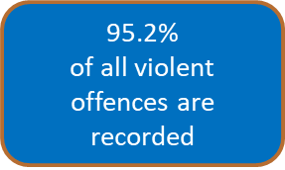
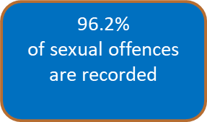
Contacting the police - 999
Crime Volumes & Arrests
Overall recorded crime has increased marginally by 1.1% (+506 offences) compared with the previous year, reaching 46,132 offences, equating to a crime rate of 56.37 offences per 1,000 population.
The increase is being driven primarily by Violence Against the Person, which rose by 5.9% (+1,056 offences) and remains the largest crime category, accounting for over 40% of all recorded crime with a rate of 23.03 per 1,000 population. This is in part accounted for by increased recording of harassment type crimes representing increased confidence in reporting these types of crimes which have historically been under reported.
Several acquisitive crime categories have seen notable reductions, including Fraud (-25.8%), Bicycle Theft (-24.8%), Vehicle Offences (-16.2%), Burglary Other (-15.3%), Drug Offences (-13.8%), and Residential Burglary (-8.1%), indicating reductions across many traditional volume crime types.

Slide 7
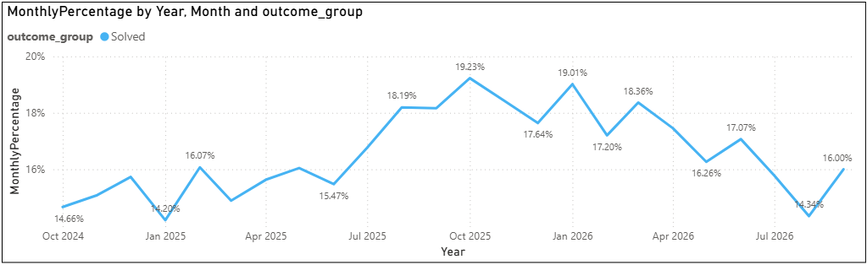
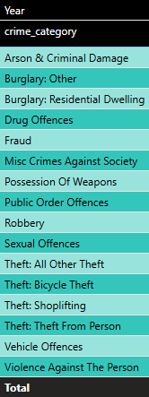

Contacting the police - 999
Crime Outcomes
Positive outcome rates have returned to 2025 levels in part due to changes in recording of positive outcomes under the new heading of ‘Solved’ outcomes which discounts Out of Court Disposals previously counted within that heading.
The decrease over the summer months is now starting to increase again as demand stabilises and investigations now come to conclusions.
National levels available at end of July 2026 was 14%, whilst North Yorkshire was at 16%.
Home Office Outcome Counting Rules changed 1st July 2026

Slide 8
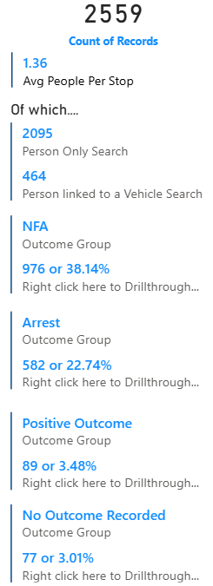
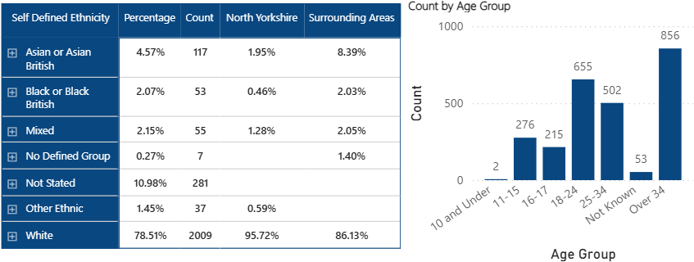
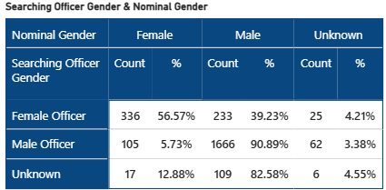
Force legitimacy (Stop Search – Ethnicity)
Date Period: 01st October 2025 – 30th September 2026
Searches on Under 18 by Officer Gender

Slide 9
Contacting the police - 999
North Yorkshire Police Workforce at 31st August 2026
These figures represent headcount and full time equivalent
Total Workforce
Neighbourhood Policing Teams
Total Workforce | Headcount | Full Time Equivalent
Police Officers | 1653 | 1637.71
PCSO's | 124 | 118.03
Police Staff | 1289 | 1177.14
Neighbourhood Policing | Headcount | Full Time Equivalent
Police Officers | 132 | 129.71
PCSO's | 117 | 111.22
Special Constables
71
Volunteers
178
Police Cadets
49

